Slide 1
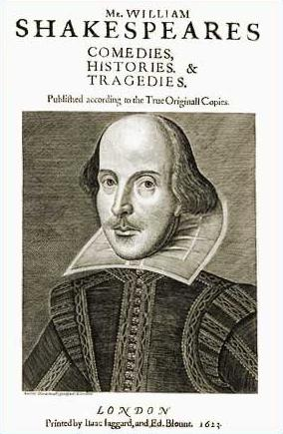
Backgrounds to Shakespeare’s Theatre
Droeshout Engraving 1623

Slide 2
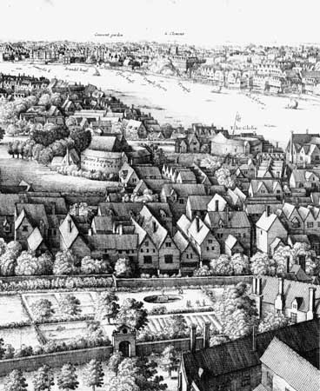
In 1600 London’s population had grown to around 200,000, in a nation of five million. London was more than ten times as large as England’s greatest provincial city, Norwich -- a predominance unmatched by that of any other western metropolis save Amsterdam. The city’s population would swell even larger at different times of the year as farmers and merchants brought goods to town. It is estimated that one in six Englishmen would visit London each year. (Browner)
Long View of London from Bankside, 1647, Wenceslaus Hollar (detail)

Slide 3
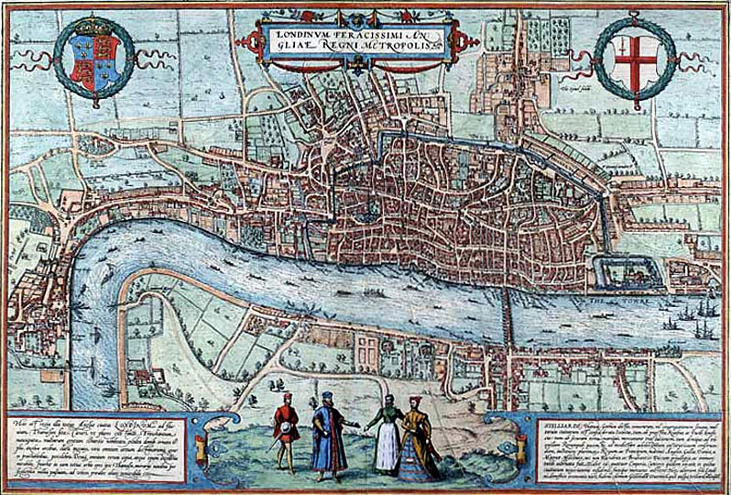
Agas Map of London 1572

Slide 4
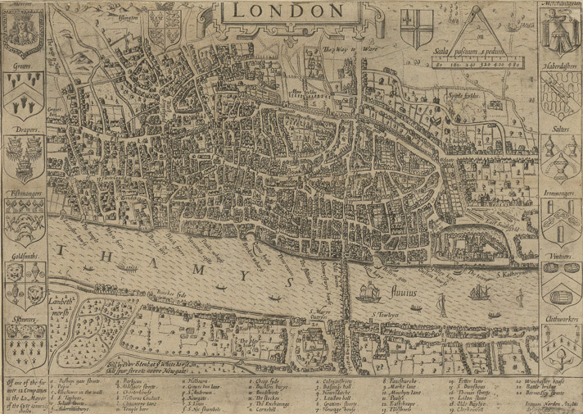
Norden, Map of London (1593)

Slide 5
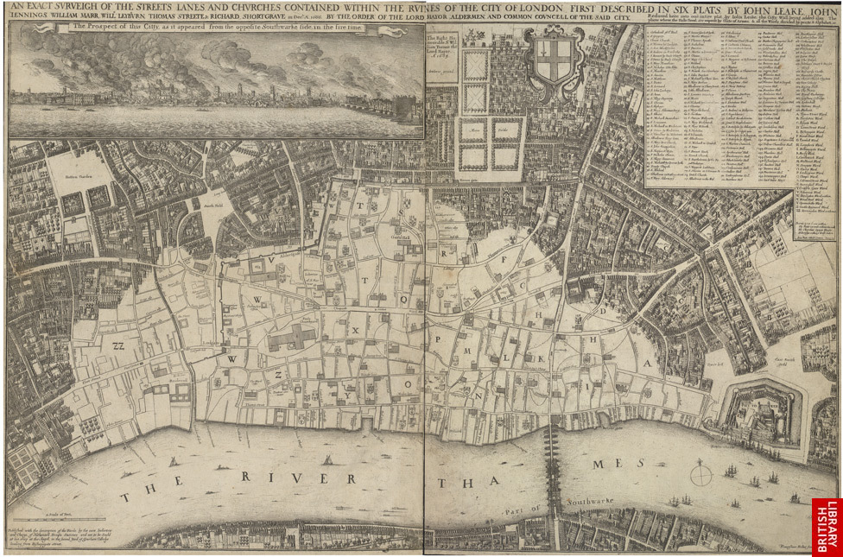
Hollar Map of London after the Great Fire of 1666

Slide 6
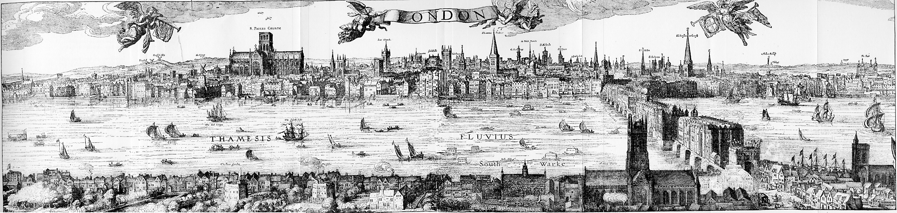
Central London Viewed from the East
London (1616) (from Visscher’s Panorama)

Slide 7
Central London Viewed from the East
London (1616) (from Visscher’s Panorama)

Slide 8
Central London Viewed from the East
London (1616) (from Visscher’s Panorama)

Slide 9
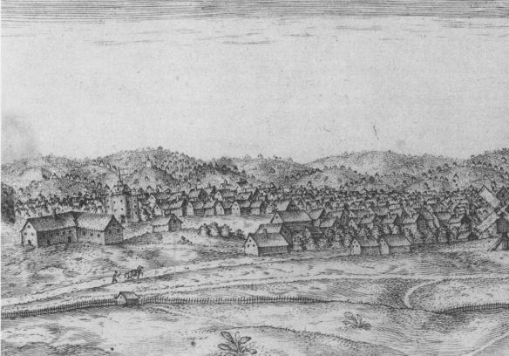
Central London Viewed from the West:
At the eastern end stands a large angled building that may be the ‘great tiled Timber barne’ associated with the Theatre, which rises behind it and is identifiable by its flag. West of The Theatre there flies a second flag, evidently belonging to the Curtain. (Utrecht Panorama 1597)

Slide 10
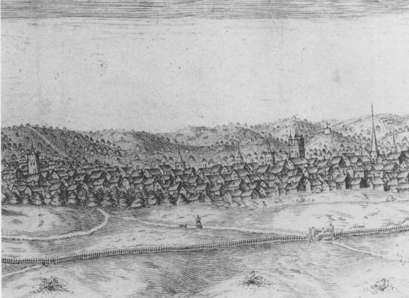
Central London Viewed from the West:
Farther west the two prominent church towers are St. Luke’s in Old Street and St. Bardolph’s without Bishopsgate. The spire to the right of St. Bardolph’s may be that of All Hallows-on-the-Wall. In the distance, between St. Botolph’s and the spire, a flagged structure appears on a hill above Greenwich, the site of Duke Humphrey’s tower. (Utrecht Panorama 1597)

Slide 11
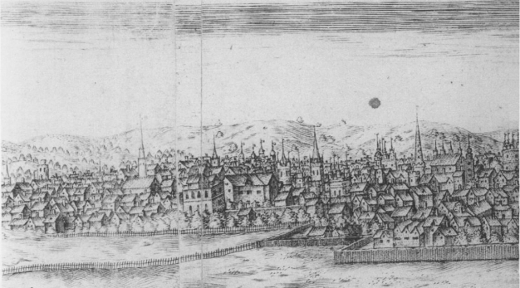
Central London Viewed from the West:
This section is bounded by the steeple of the Dutch Church (Austin Friar’s) on the left and St. Paul’s Cathedral on the right. Immediately to the right of the Dutch Church are three church towers, St. Olave’s in Hart Street, St. Peter’s in Cornhill, and St. Michael’s in Cornhill. In the distance beyond St. Peter’s are the flagged turrets of the Tower. To the right of St. Michael’s rise the decorative column atop the Royal Exchange, the steeple of St. Dunstan’s in the East, the pinnacles along the roof of the Guildhall, the tower of St. Lawrence Jewry (with four finials) the soaring spire of St. Lawrence Poultney, the tower of All Hallows the Great, and the ‘crown’ spire of St. Mary-le-Bow. (Utrecht Panorama 1597)
Notes:
This section is bounded by the steeple of the Dutch Church (Austin Friar’s) on the left and St. Paul’s Cathedral on the right. Immediately to the right of the Dutch Church are three church towers, St. Olave’s in Hart Street, St. Peter’s in Cornhill, and St. Michael’s in Cornhill. In the distance beyond St. Peter’s are the flagged turrets of the Tower. To the right of St. Michael’s rise the decorative column atop the Royal Exchange, the steeple of St. Dunstan’s in the East, the pinnacles along the roof of the Guildhall, the tower of St. Lawrence Jewry (with four finials) the soaring spire of St. Lawrence Poultney, the tower of All Hallows the Great, and the ‘crown’ spire of St. Mary-le-Bow.

Slide 12
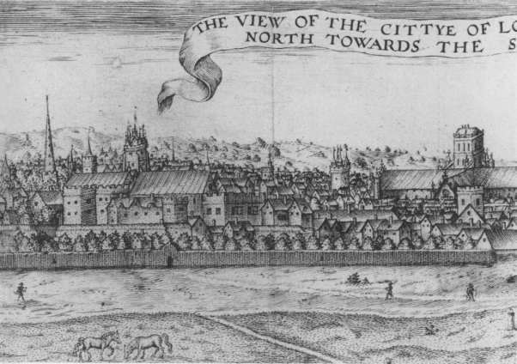
Central London Viewed from the West:
To the right of Bow Church is the modest tower of St. Bartholomew the Great, and to the left of St. Paul’s is the tower, more distant but massive, of St. Saviour’s (now Southwark Cathedral). North of St. Paul’s crossing is St. James Clerkenwell; and north of the Bow Church, the crenellated priory of St. John of Jerusalem. (Utrecht Panorama 1597)
Notes:
To the right of Bow Church is the modest tower of St. Bartholomew the Great, and to the left of St. Paul’s is the tower, more distant but massive, of St. Saviour’s (now Southwark Cathedral). North of St. Paul’s crossing is St. James Claerkenwell; and north of the Bow Church, the crenellated priory of St. John of Jerusalem. The square building that Hotson mistakenly identified as the Fortune is near the left end of this section, fronting the fields and lined up with St. Olave’s.

Slide 13
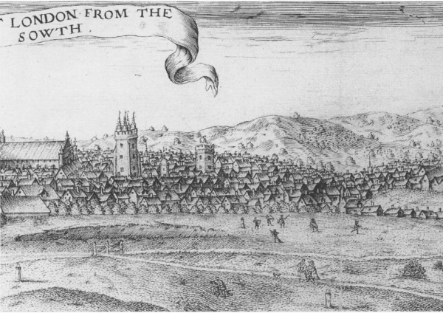
Central London Viewed from the North:
Immediately to the right of St. Paul’s are St. Sepulchre and St. Martin’s Ludgate, and farther west, St. Bride’s and St. Andrew’s Holborn, (Utrecht Panorama 1597)
Notes:
Immediately to the right of St. Paul’s are St. Sepulchre and St. Martin’s Ludgate,

Slide 14
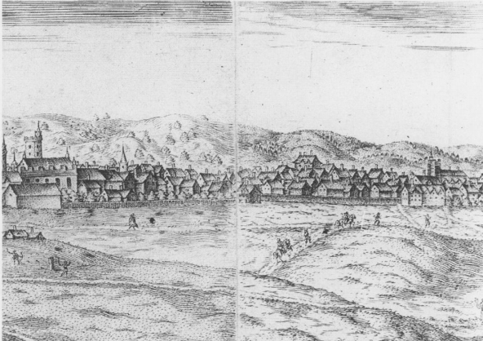
Central London Viewed from the West:
and farther west, St. Bride’s and St. Andrew’s Holborn, north of St.
Andrew’s stand the chapel and hall of Ely Place. (Utrecht Panorama 1597)
Notes:
Andrew’s stand the chapel and hall of Ely Place.

Slide 15
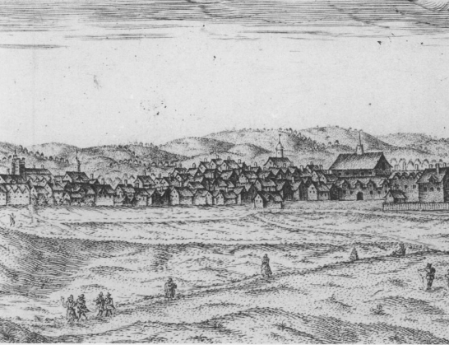
Central London Viewed from the West:
Ranged above the rooflines are the towers of St. Dunstan’s in the West, the Middle Temple, and St. Clement’s Danes. The prominent structure west and north of St. Clement’s is the hall of Gray’s Inn. (Utrecht Panorama 1597)
Notes:
Ranged above the rooflines are the towers of St. Dunstan’s in the West, the Middle Temple, and St. Clement’s Danes. The prominent structure west and north of St. Clement’s is the hall of Gray’s Inn. To the far west and south looms

Slide 16
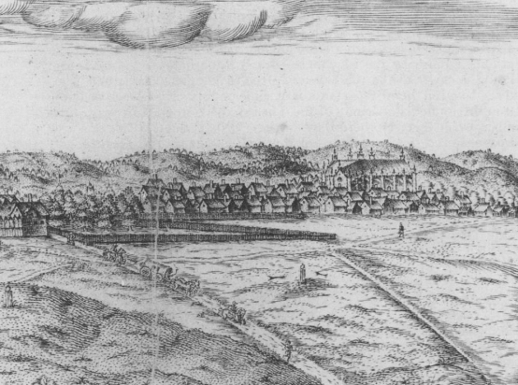
Central London Viewed from the West:
To the far west and south looms Westminster Abbey. The flagged turrets in the distance between Gray’s Inn and Westminster Abbey may belong to Lambeth Palace. (Utrecht Panorama 1597)
Notes:
Westminster Abbey. The flagged turrets in the distance between Gray’s Inn and Westminster Abey may belong to Lambeth Palace.

Slide 17
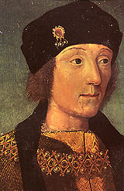
English Drama, which flowered in the age of Elizabeth, had been developing for centuries. By the time Henry VII became King of England in 1509, drama extended to all corners of the Commonwealth and to every level of Tudor society. Drama was available in many forms. In a single community one could attend a saints play at the local parish church, a Corpus Christi pageant in the local market square, a morality play or interlude at the guildhall and a folk play on the village green. The King was regularly entertained with masques, pageants and dramatic interludes at court banquets. He also personally supported drama through his patronage of both adult and children’s groups. (O’Brien)
Henry VII

Slide 18
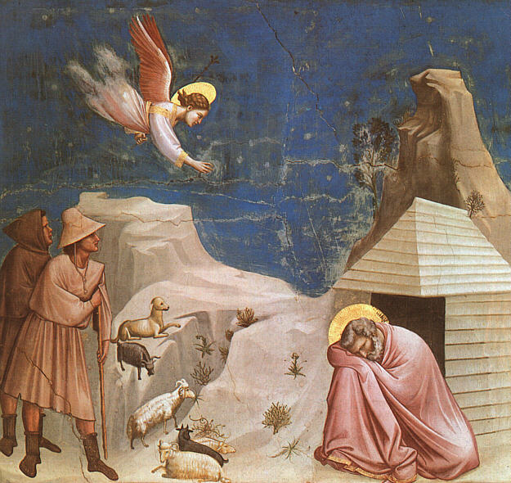
Miracle Plays: The earliest form of English Drama were the Miracle plays which depicted the lives, miracles, and martyrdom of saints. Initially, the plays enhanced religious feast days and festivals, beginning in the 10th and 11th centuries. As their popularity spread, the plays were written in the vernacular and used to teach Bible stories to a largely illiterate population. By the 13th century, miracle plays were being performed at public festivals. Mary and St. Nicholas were two of the favorite subjects. During the Reformation, Miracle plays in England were finally banned by Henry VIII. Only two English Miracle plays survive: The Conversion of Saint Paul and Mary Magdalene. (Vernacular Drama of the Middle Ages )
Scenes from the Life of Joachim: 5. Joachim's Dream 1304-06 Fresco, 200 x 185 cm Cappella Scrovegni (Arena Chapel), Padua

Slide 19
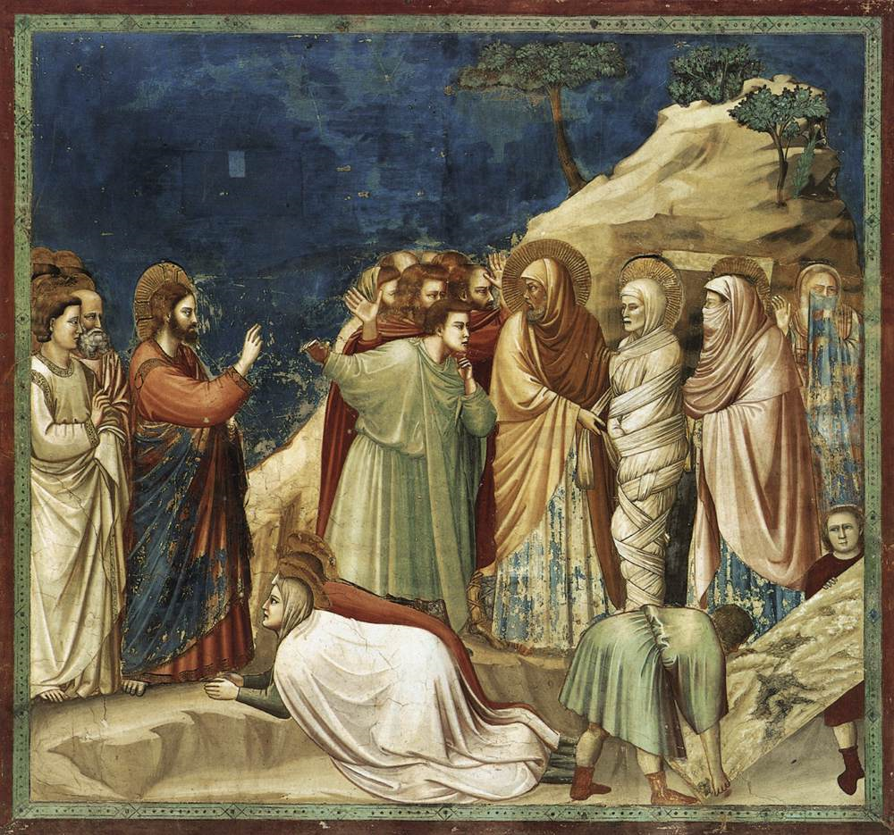
Mystery Plays
During the 15th century, pageant presentations of Bible stories associated with church holidays became popular parts of holiday festivals. Different professional guilds were responsible for staging these pageants which told Bible stories like the Fall of Lucifer, Cain and Abel, Noah and the Flood, the Raising of Lazarus, the Nativity, the Crucifixion, the Harrowing of Hell, and the Resurrection. Frequently, the pageants were put on floats and rolled through streets, even from town to town. (Wikipedia)
Giotto, Scenes from the Life of Christ: 9. Raising of Lazarus 1304-06 Fresco, 200 x 185 cm Cappella Scrovegni (Arena Chapel), Padua
The York Crucifixion

Slide 27
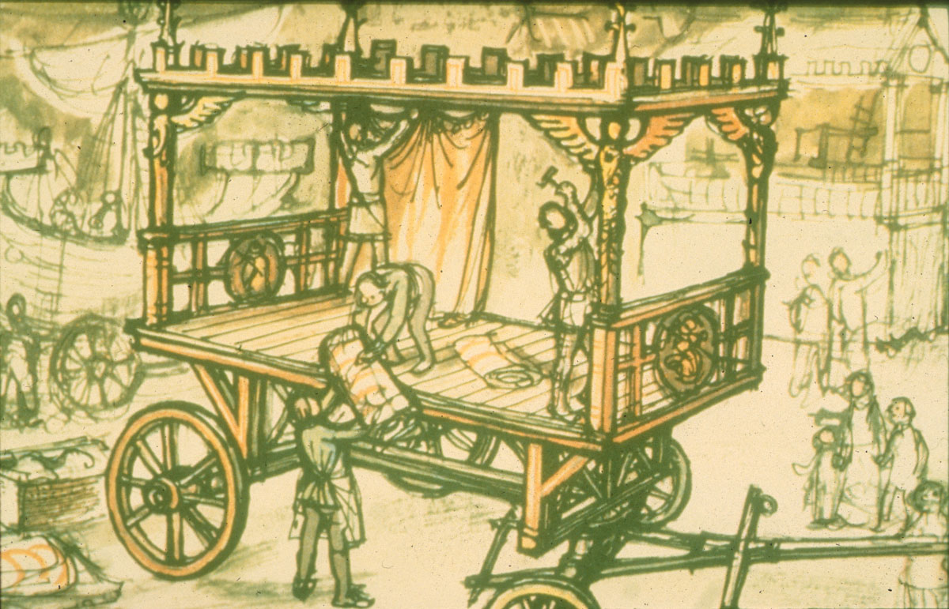
Mystery Play Wagon

Slide 28
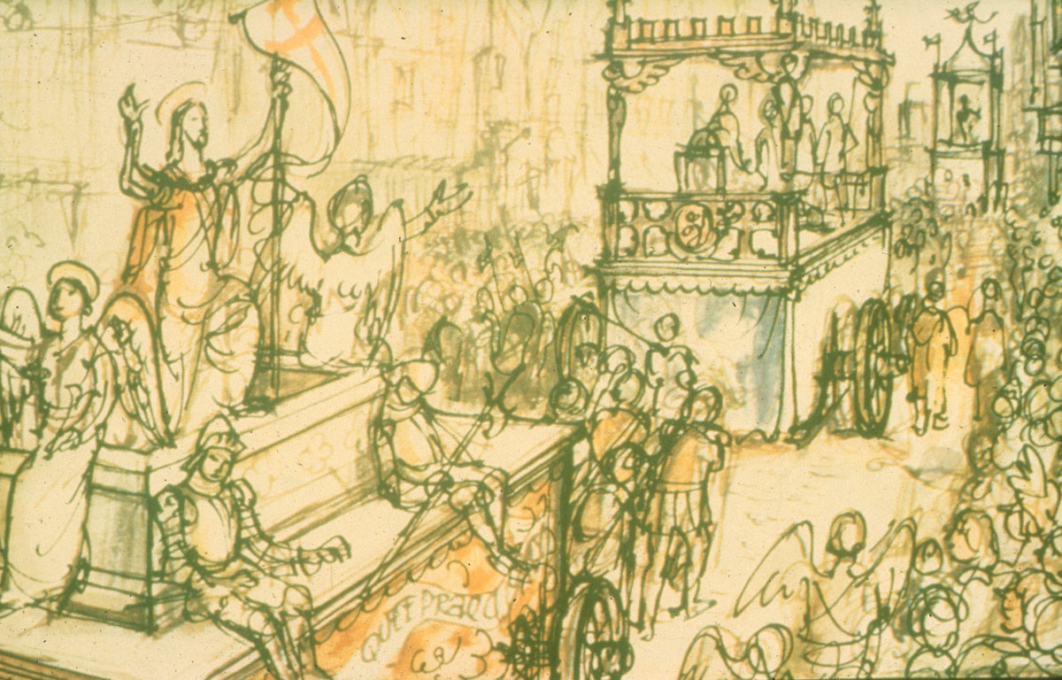
Mystery Play Wagons

Slide 29
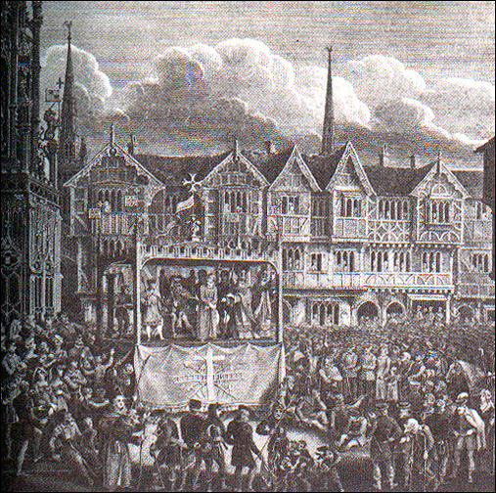
Middle English pageant wagon.scene of Christ before Pilate. From Sharp, A Dissertation
on the Pageants... (1825)

Slide 30
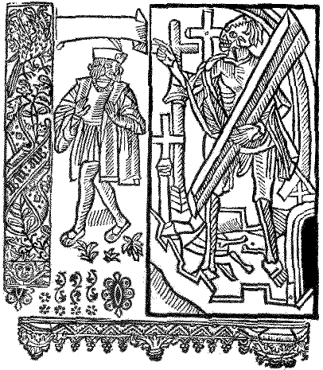
Morality Plays
After the ban of Mystery plays during Henry VIII’s reign, Morality plays were intended to teach religious values, but their message was not tied to the static theology of the scriptures . The form had become flexible enough to include the personal views of the author towards political, religious or moral matters. The most famous morality play of the 16th c. was entitled Everyman. In this allegory our hero is tempted by the Devil and struggles for his soul with the seven deadly sins. (O’Brien)
Title Page of Everyman

Slide 31
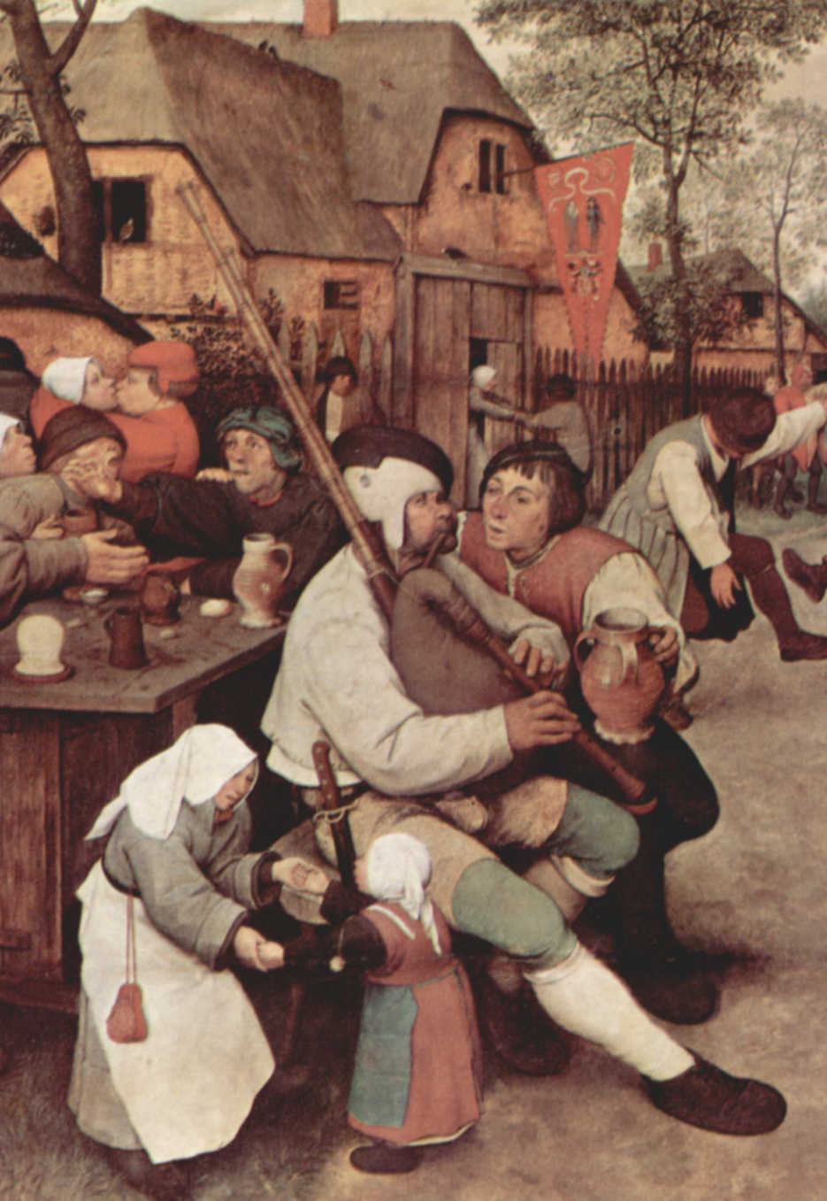
Holiday Festivals
Elizabethan holidays provided ample opportunities for dramatic play. During these holidays entire communities embraced the Dionysian spirit and assumed traditional roles drawn from folk traditions. For instance, on May Day it became the custom to get up early and go into the woods to select a tall elm, cut it down, paint it and erect it in a public place, then it was adorned with garlands, ensigns and streamers. So prevalent was early rising on May Day that Shakespeare refers to it in Henry VIII:
Pray Sir, be patient: tis as much impossible
(Unless we sweep them from the door with cannons,)
To scatter them, as tis to make them sleep
On May-day morning; which will never be.
(Lancashire)
Peter Breugel, Detail from The Peasant Dance, 1568

Slide 32

Peter Breugel, The Peasant Dance, 1568

Slide 33
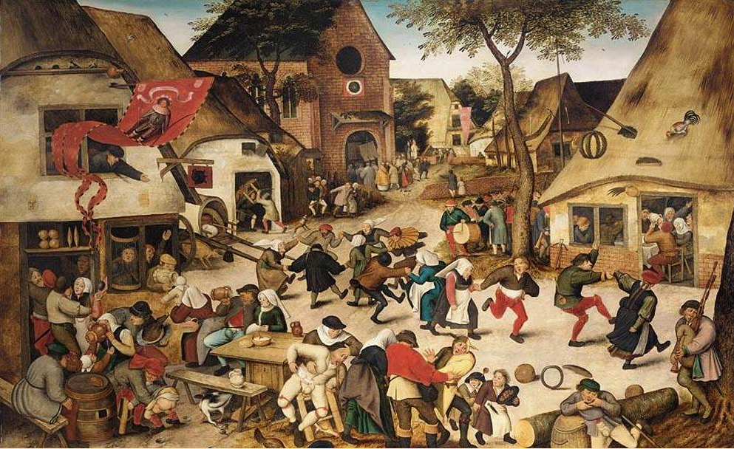
Peter Breughel the Younger, The Kermesse of St George 1628

Slide 34
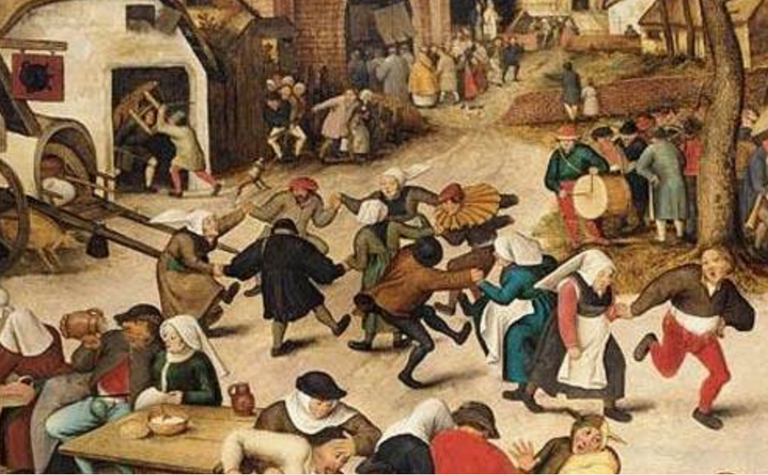
Detail from Peter Breughel the Younger, The Kermesse of St George 1628

Slide 35
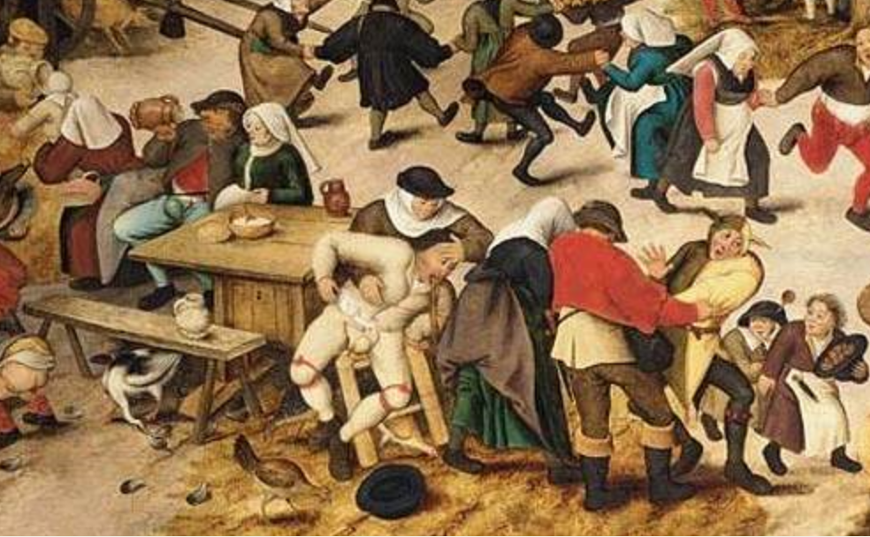
Detail from Peter Breughel the Younger, The Kermesse of St George 1628

Slide 36
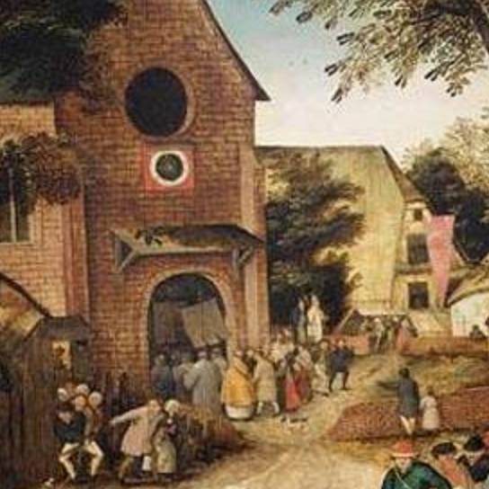
Detail from Peter Breughel the Younger, The Kermesse of St George 1628

Slide 37
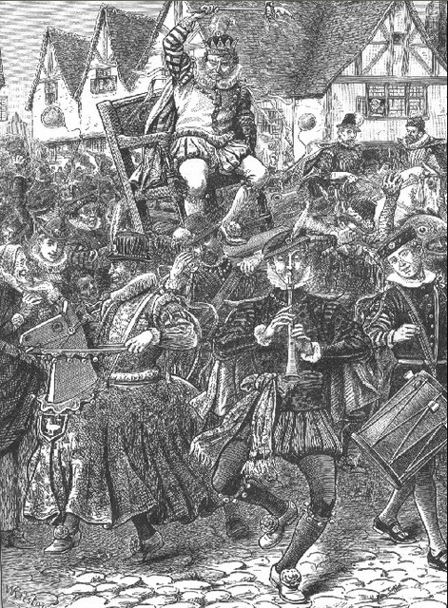
Twelfth Night’s Lord of Misrule
Much of the Christmas season’s merriment derived from the pagan traditions of the Roman Saturnalia which celebrated the Winter Solstice holiday by allowing servants to switch roles with masters and rule for a day. The early Church fathers appropriated key aspects of this holiday to celebrate the birth of Jesus: feasting, gift giving, cross dressing, tomfoolery, and the Lord of the Holiday, St. Nicholas. (Wikipedia)

Slide 38
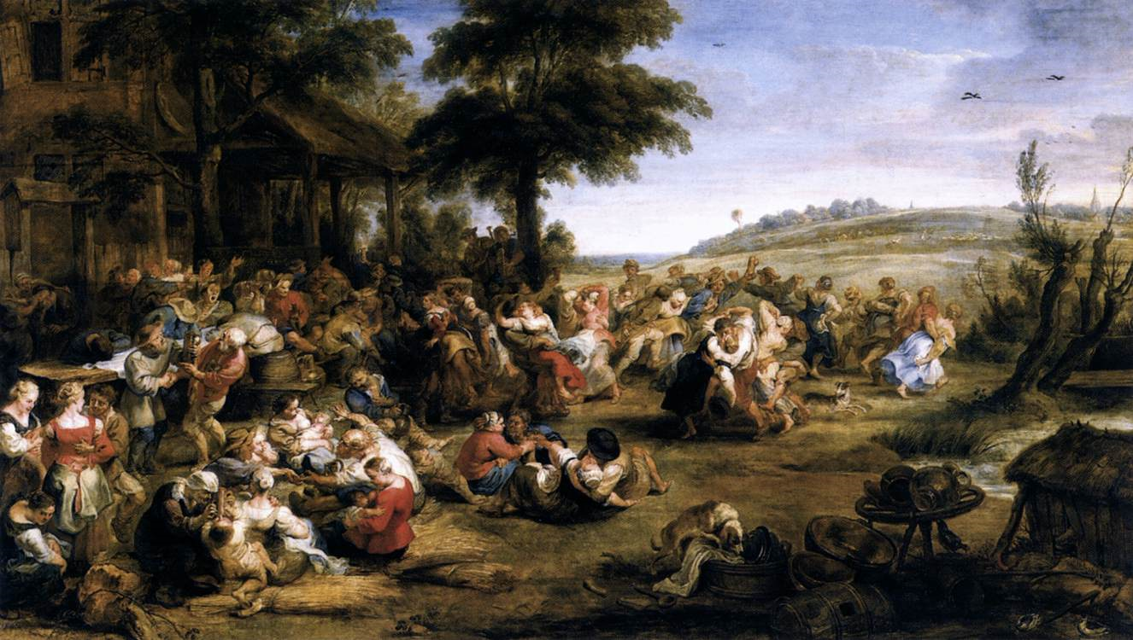
Rubens The Kermiss 1635-38

Slide 39
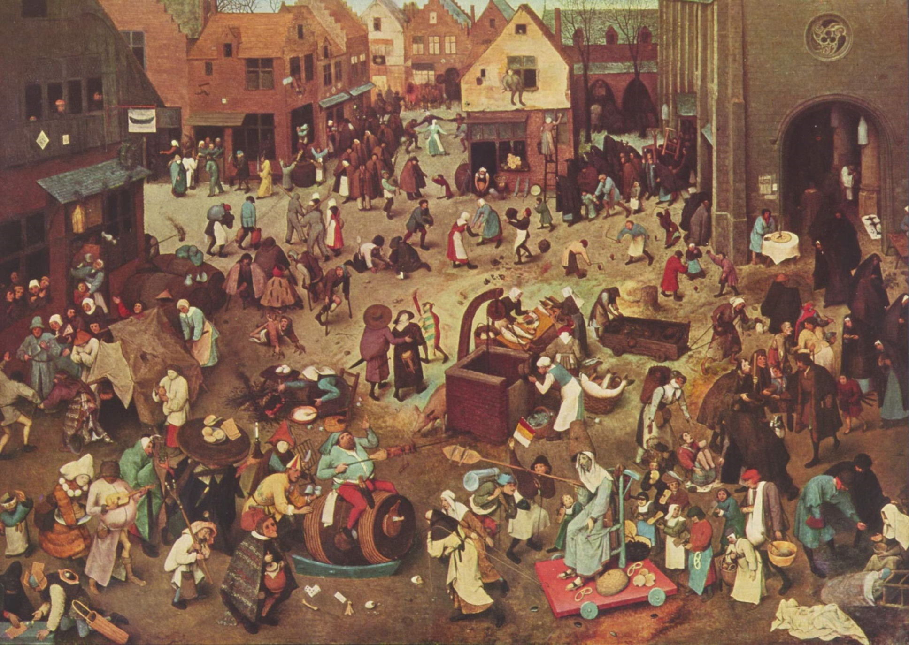
Peter Breughel. The Fight Between Carnival and Lent, 1559

Slide 41


Slide 42
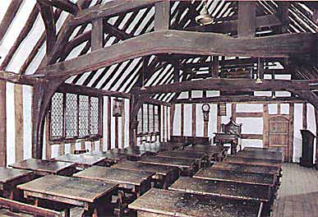
Early English drama was also influenced by Renaissance Humanism which emphasized training in the classical rhetorical forms that had originated in Greece and Rome. Drama became a major means for the teaching of Latin in schools in England. The comedies of Plautus and Terence provided the first and probably the most extensive study of drama for the Renaissance schoolboy. Initially the commentators treated the plays as purely academic texts, but as the sixteenth century moved on, the plays began to be performed in schools and universities. In Christ Church Oxford it was established that Christmas festivities would include two comedies and two tragedies each year. It is likely that the schools followed suit, particularly given they were the training ground for privileged young men moving on to University which they did at around the age of fourteen. (O’Brien)
The upper Guildhall in Stratford upon Avon which has been used as a schoolroom since Shakespeare's time.

Slide 43
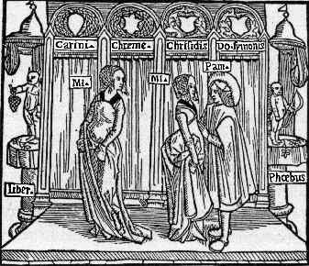
As the century progressed, Latin texts began to be"Englysshed," and Classical plays began to be adapted into specifically English forms. In 1553, a schoolmaster named Nicholas Udall wrote an English comedy titled Ralph Roister Doister based on Plautus and Terence. The play was the first to introduce the Latin character type miles gloriosus ("braggart soldier") into English plays; the type was later honed to perfection by Shakespeare in the character of Falstaff. Around the same time at Cambridge, the comedy Gammer Gurton's Needle, possibly by William Stevens of Christ's College, was amusing the students. It paid closer attention to the structure of the Latin plays and was the first to adopt the five-act division. Renaissance English Drama: From Medieval to Renaissance

Slide 44
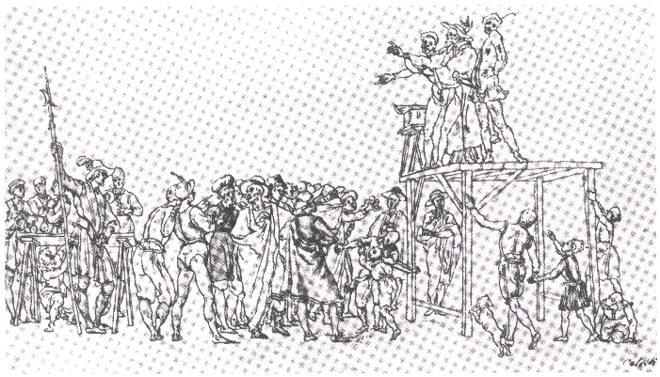
During the 1570’s travelling theatrical companies brought secular plays to venues in town halls and marketplaces throughout England. Early plays like Clyomon and Clamydes, featuring cardboard monsters and knockabout clowns, attracted large audiences by combining spectacular romantic escapism with moral lessons.

Slide 45
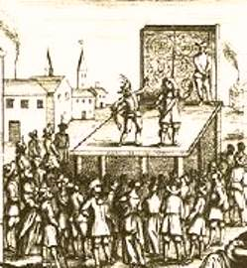
Early English comedy was influenced by the Commedia dell'arte , the Italian improvisational street theatre in which actors took the roles of recognized types in stock situations. Actors wore the masks of the Pantalone (old cuckold), the Doctor, the young Wife, the dashing Captain, the wily Jester (Zanni), the bawdy maid, and the hunchback Puchinello. Commedia plots typically revolved around disgraceful love intrigues or clever tricks to get money by outwitting some simpleton. Plots involved long-lost children stolen by the Turks, plotting maids, bragging captains, aged fathers and wily widows. Each gentleman had his parasite, each woman her confidante. There were night scenes, in which the hero was mistaken for the villain; cases where father and son fall in love with the same girl; and risqué situations--the representation of fire, shipwreck, and the like which served as a pretext for allowing actresses to race naked across the stage. (Piccolo Theatre)
Internet Shakespeare

Slide 46
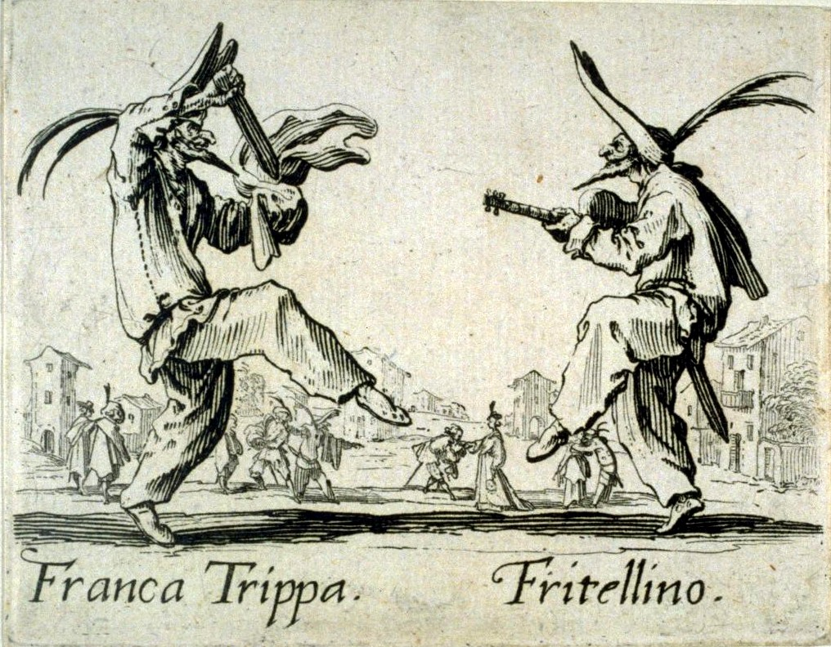
Jacques Callot, first quarter of the 17th century.

Slide 47
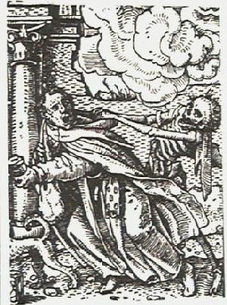
The most influential writer of classical tragedies for the Elizabethans was the Roman playwright Seneca, whose works were translated into English by Jasper Heywood in 1589. Seneca's plays incorporated rhetorical speeches, blood and violence, and often ghosts. These elements would figure prominently in many popular Elizabethan and Jacobean plays. The first English revenge tragedy in the Senecan mould was Gorboduc (1561), written by two lawyers, Thomas Sackville and Thomas Norton, at the Inns of Court in London. The play is also important as the first English play to be written in blank verse. Blank verse (non-rhyming lines in iambic pentameter) was introduced into English literature by the sonneteers Wyatt and Surrey in the 1530's. Its use in Gorbuduc paved the way for Kid’s Spanish Tragedy and then "Marlowe's mighty line" and the exquisite poetry of Shakespeare's dramatic verse. Renaissance English Drama: From Medieval to Renaissance

Slide 48
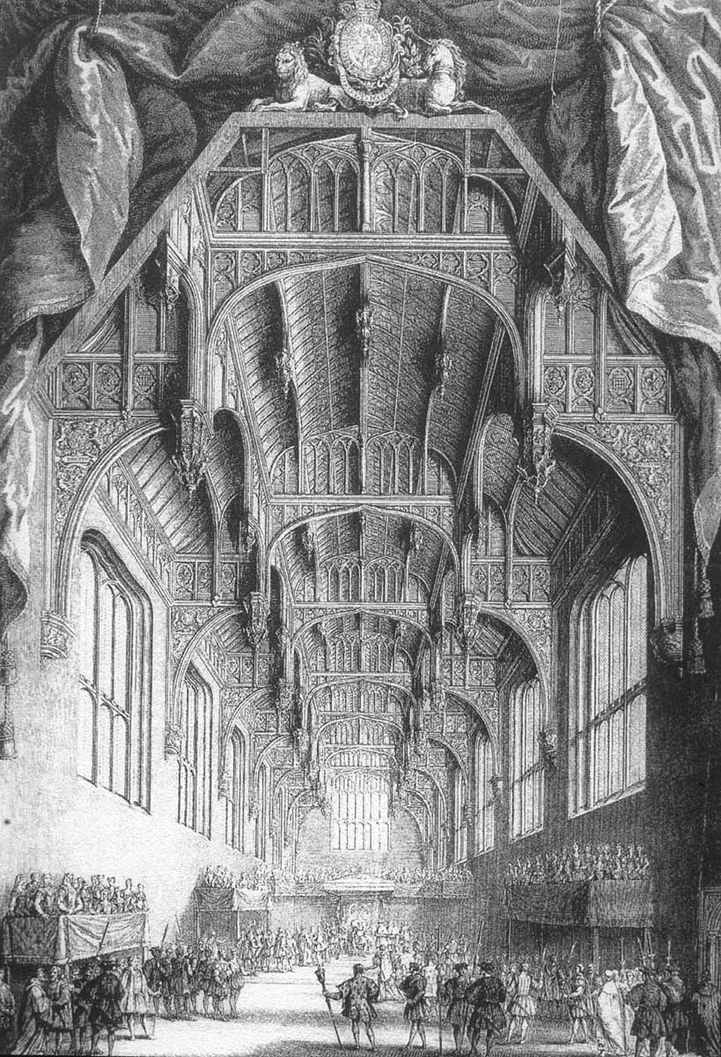
By the 1570’s, noblemen vied for the queen’s attention by presenting plays at court. The Earl of Leicester and the Earl of Sussex each fielded companies in these ostentatious displays. Tensions became so high that Lord Walsingham, the Queen’s chief of security, intervened and created one company, the Queen’s Men. with the best players from throughout the land. The Queen’s Men exercised a monopoly in the Inns of London and the festivals at court. The larger size of this company also gave playwrights the opportunity to create more ambitious dramas of a purely secular nature. (Gurr 144)
Hampton Court Great Hall

Slide 49
Founded in 1583 under the aegis of Queen Elizabeth I, the Queen’s Men were drafted from existing troupes such as Leicester's Men and Sussex's Men to form an all-star company. Until the beginning of the 1590s, they performed regularly at court during the annual Christmas festivities, they were popular among London's discerning theatre audiences, and they were certainly the most popular company in the nation. Traveling well-worn routes through the provinces, the Queen's Men pioneered the types of verse dramas that Marlowe and Shakespeare would exploit in the 1590’s. Shakespeare certainly relied on the Queen's Men's plays when writing his own histories, taking plots, characters, and occasionally phrases from The True Tragedy of Richard III, for instance, or The Famous Victories of Henry V. (Queen’s Men)
Notes:
Shakespeare's professional relationship with the Queen's Men is unclear and it is likely to remain unclear unless new evidence is discovered, but Shakespeare certainly relied on the Queen's Men's plays when writing his own histories, taking plots, characters, and occasionally phrases from The True Tragedy of Richard III, for instance, or The Famous Victories of Henry V. Less precisely, the Queen's Men's also seem to have influenced Shakespeare's comic sensibility and they perhaps suggested to him the dramatic effectiveness of the juxtaposition of high and low scenes - a device that the Queen's Men use to great effect in most of their plays.

Slide 50
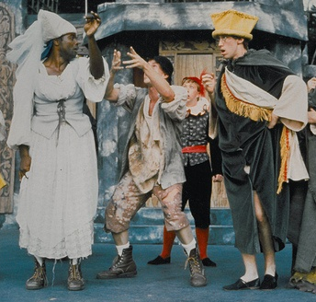
The Queen’s Men pioneered the types of plays which Marlowe and Shakespeare would exploit and developed the London audiences which would later throng to the new amphitheatres. The Famous Victories of Henry V mixed high and low characters in a multi-lined plot celebrating patriotic themes. The Spanish Tragedy took Seneca’s revenge tragedy in new directions, by featuring multiple plot lines and frequent changes of scene in this lurid tale of a father feigning madness in the Spanish court to discover the murderer of his son. ) Gammer Gurton’s Needle is a rollicking farce about a village gossip who loses her iron needle. The play features the kind of improvised exchange between actor and audience which became a staple of early English comedy.
Scene from Gammer Gurton’s Needle

Slide 51
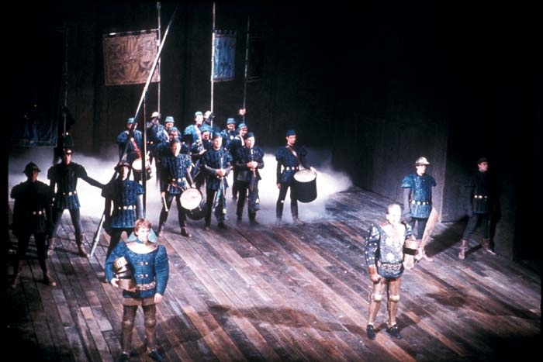
The Famous Victories of Henry V

Slide 52
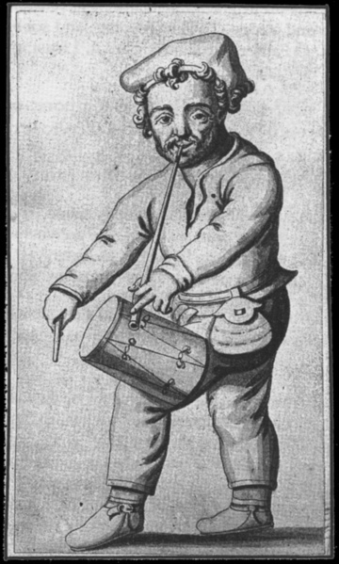
Richard Tarleton was the Queen’s Men’s famous clown, a national celebrity. His manner of performance combined the styles of the medieval Vice, the professional minstrel, and the amateur Lord of Misrule. During perfromances, he took it upon himself to police hecklers by delivering a devastating rhyme when necessary. He would spend time after the play in a battle of wits with the members of the audience. He was Elizabeth's favorite clown, and his talent for impromptu doggerel on subjects suggested by his audience has given his name to that form of verse. His most famous role was as the country bumpkin who finds himself at large in the big city of London. Some have suggested that the evocation of Yorick in Hamlet's soliloquy was composed in memory of Tarlton. (Wikipedia)

Slide 53

Heads on London Bridge South Gate
Perhaps the most popular from of public entertainment in Elizabethan London, though, was public punishment. Officials relied upon gruesome blood spectacles to maintain law and order. Just being accused of a serious crimes could well result in torture. A defendant's chance of receiving any acquittal in court was extremely slim. William Harrison describes the most dreadful punishment of being Hung, Drawn and Quartered : "The greatest and most grievous punishment used in England for such as offend against the State is drawing from the prison to the place of execution upon an hurdle or sled, where they are hanged till they be half dead, and then taken down, and quartered alive; after that, their members and bowels are cut from their bodies, and thrown into a fire, provided near hand and within their own sight, even for the same purpose." Elizabethan Crime and Punishment

Slide 54
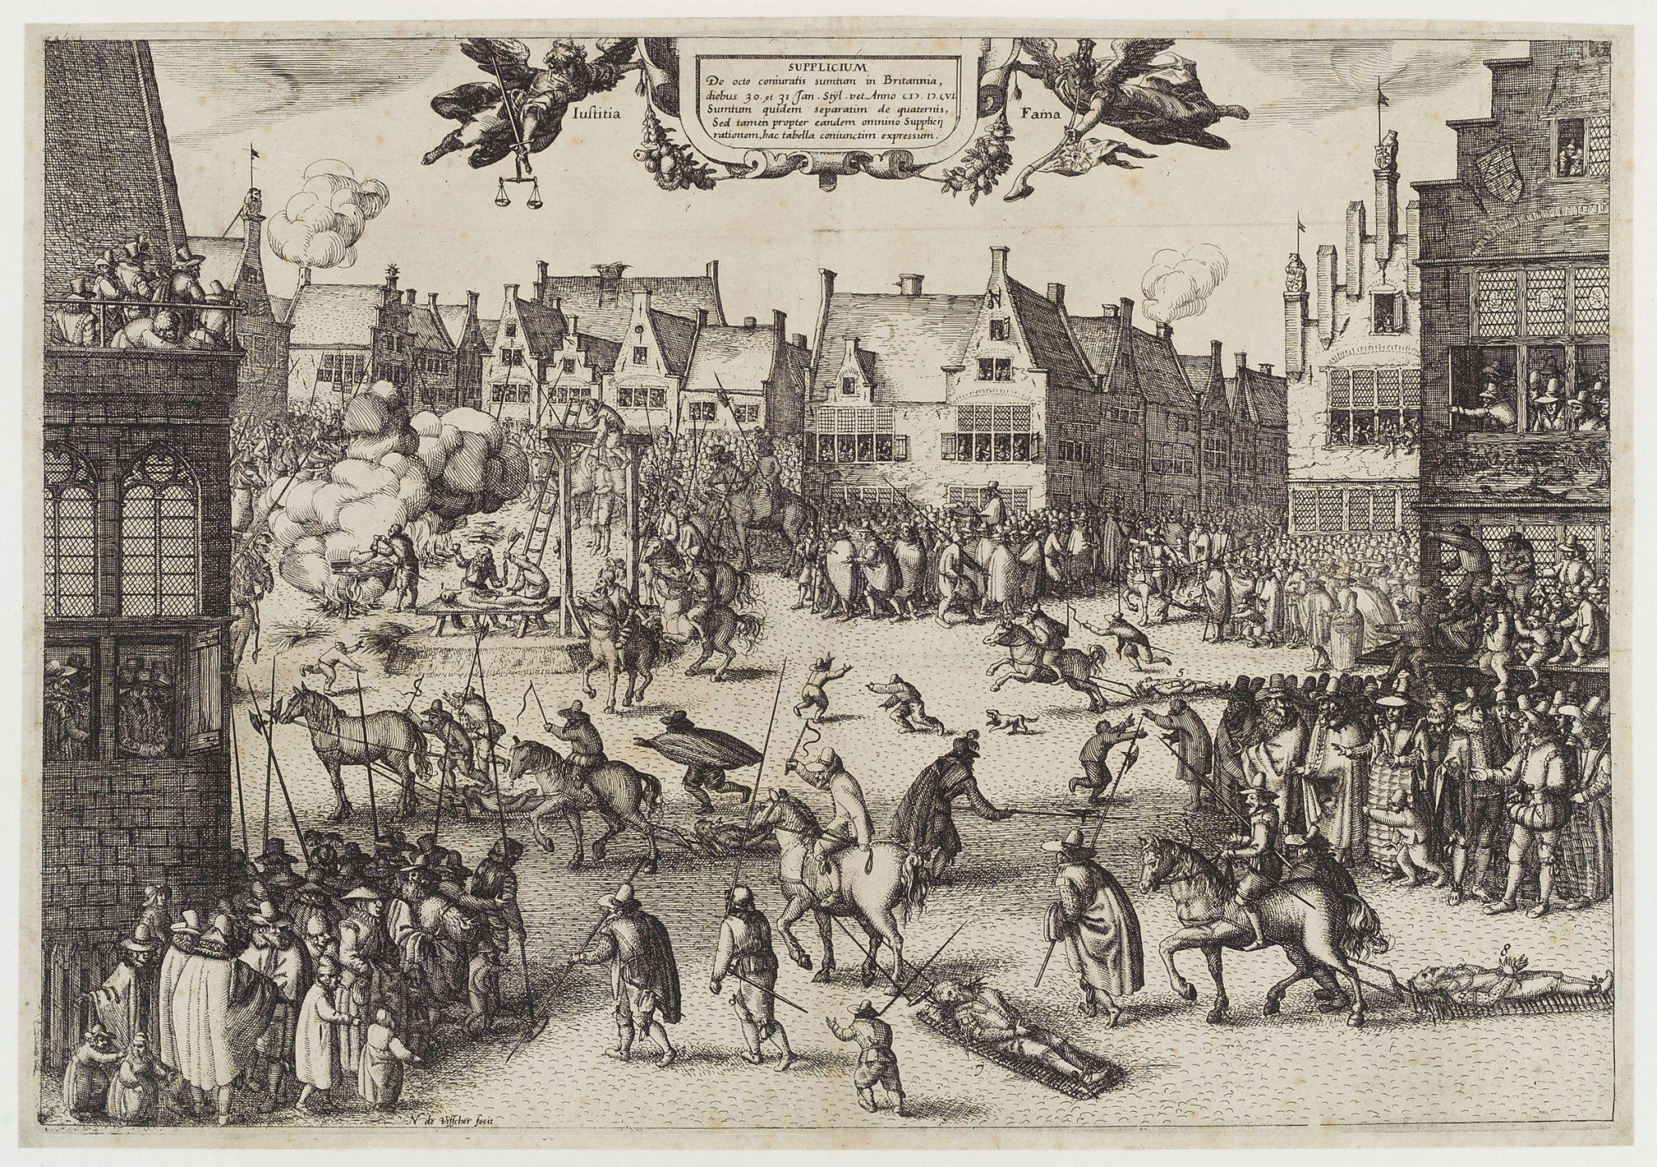
Execution of the Gunpowder Plotters 1605

Slide 55
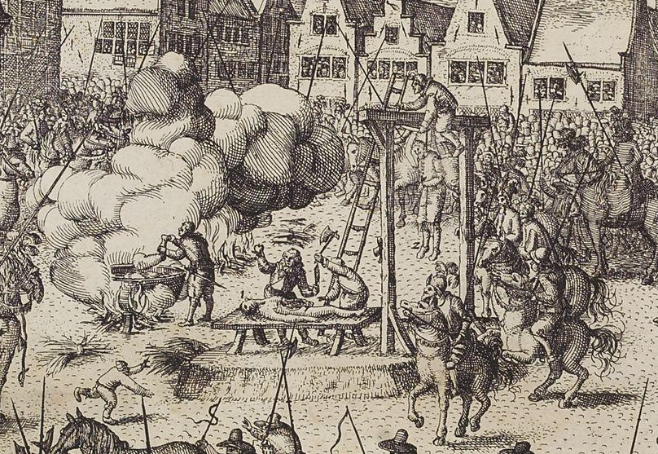

Slide 56
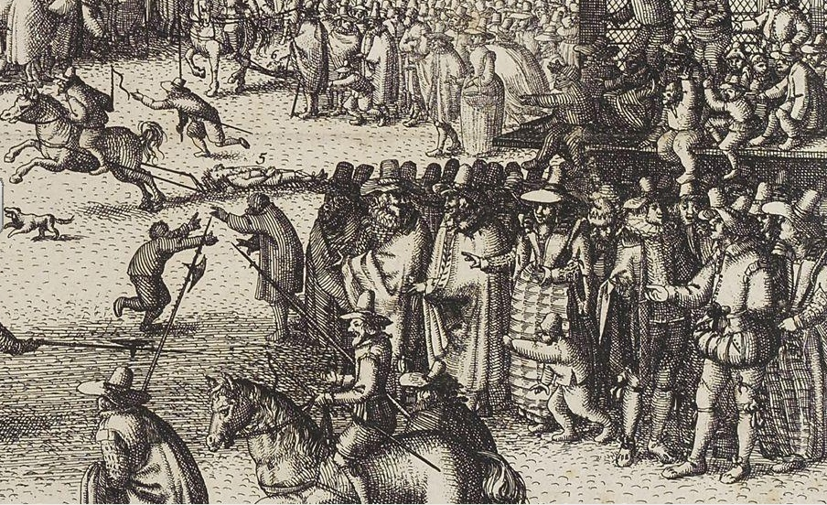

Slide 57
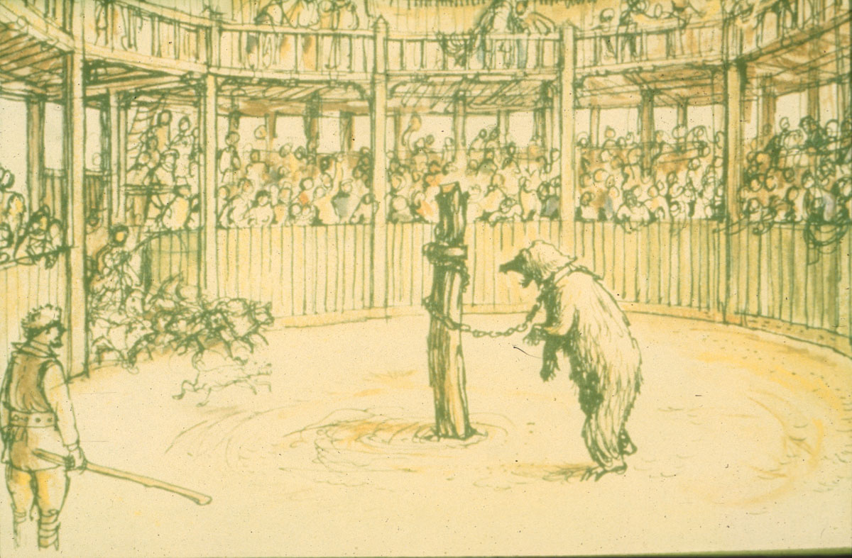
Another Elizabethan blood sport was Bear-baiting. Bankside was the chief home of the rougher and crueller delights of bear-baiting which consisted largely of harassing and tormenting an animal by the setting-on of dogs, although other methods could be used. One example of the range and savagery of this sport is drawn from a Jacobean notice for a Thursday exhibition at one of the Bankside beargardens: "The gamstirs of Essex," it advertises, "chalenge all comers -- to plaie .v. dogges at the single beare for .v. pounds and also to wearie a bull dead at the stake." In addition, there was to be "plasant sport with the horse and ape and whiping of the blind beare.“ (Browner)
Bear Baiting

Slide 58
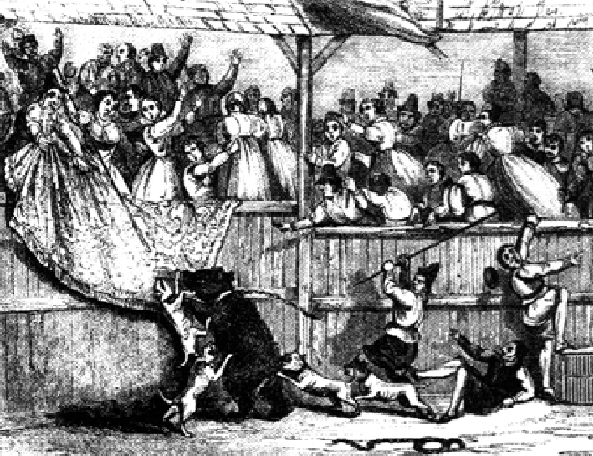
Bulls were, as a rule, baited to death, but the bears were not. On the contrary, they were known to the people by name, and were valued in proportion to the sport they afforded. Some, such as blind bear Harry Hunks, became famous enough to be celebrated in verse, "Hunks of the Beare-garden to be feared, if he be nigh on," wrote Henry Peacham in 1611. (Browner)
Bearbaiting in the 17th century, engraving, 1796 Hulton Getty
Notes:
A German traveller in Shakespeare's day kept a diary. He had this to say about entertainment in London:
Without the city are some theatres, where English actors represent almost every day comedies and tragedies to very numerous audiences; these are concluded with variety of dances, accompanied by excellent music and the excessive applause of those that are present. There is still another place, built in the form of a theatre, which serves for the baiting of bears and bulls. They are fastened behind, and then worried by those great English dogs and mastiffs, but not without great risk to the dogs from the teeth of the one and the horns of the other; and it sometimes happens they are killed upon the spot. Fresh ones are immediately supplied in the places of those that are wounded or tired. To this entertainment there often follows that of whipping a blinded bear, which is performed by five or six men, standing in a circle with whips, which they exercise upon him without any mercy. Although he cannot escape from them because of his chain, he nevertheless defends himself, vigorously throwing down all who come within his reach and are not active enough to get out of it, and tearing the whips out of their hands and breaking them. At these spectacles and everywhere else, the English are constantly smoking the Nicotian weed which in America is called Tobaca - others call it Paetum - and generally in this manner; they have pipes on purpose made of clay, into the farther end of which they put the herb, so dry that it may be rubbed into powder, and lighting it, they draw the smoke into their mouths, which they puff out again through their nostrils, like funnels, along with plenty of phlegm and defluxion from the head. In these theatres, fruits, such as apples, pears and nuts, according to the season, are carried about to be sold, as well as wine and ale.
From Paul Hentzner, Travels in England (l598).

Slide 59
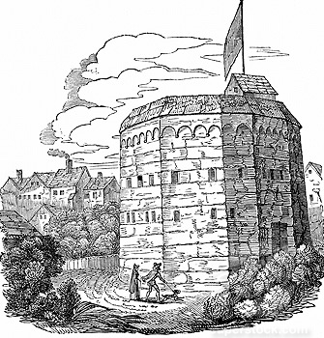
1570-1590
The great breakthrough in Elizabethan theatre took place in the 1570’s when impresarios like James Burbage realized that a growing, potentially huge audience would actually pay money for tickets to hear plays. To satisfy the demands of this new audience, a boom in theatre construction and playwriting took place. When travelling players went from town to town, they took a limited repertoire of plays with them, but in the city, in an enclosed theatre, the impresarios needed more and more new plays to satisfy their growing audience. The demand for new plays enabled this first generation of English playwrights to shake free of the didactic intent of the morality plays and create stories whose action existed solely to entertain the audience. (Gurr)
Bear Garden in Southwark 1574

Slide 60
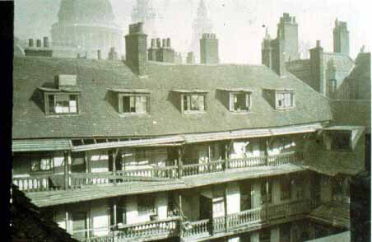
Prior to this time, the courtyards of London Inns like the Red Bull and the Oxford Arms.had served as makeshift theatres where traveling player troupes like the Queen’s Men could stage their shows. The Puritan leaders of the City government voted to ban these entertainments, forcing theatre impresarios to find new venues outside of the city.
The Oxford Arms in London

Slide 61
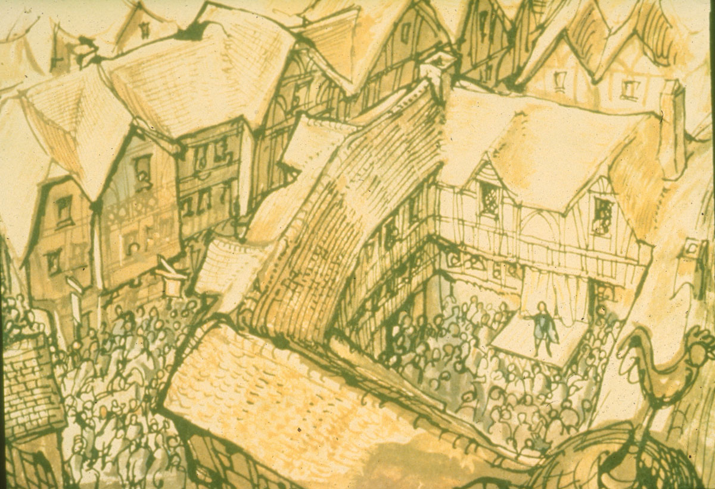
Acting Troupes Perform at Inns

Slide 62
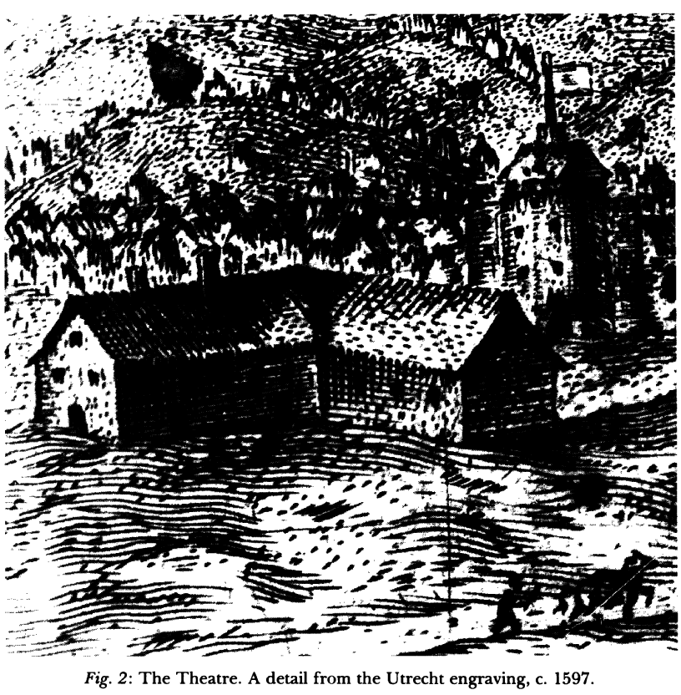
James Burbage’s The Theatre (1576) and Henry Lanman’s “The Curtain “ (1577) in Shoreditch were the first amphitheatres built in London. The View of the Cittye of London from the North towards the Sowth (Utrecht Panorama)
Notes:
A detail of 'The View of the City of London from the North towards the South' showing PRIORY of St John the Baptist, Holywell, the THEATRE, which from 1577 to 1598 was the first London building specially devoted to the performance of plays To the right isthe flag of what might be THE CURTAIN THEATRE 1577-c.1627
Second English public playhouse Here WILLIAM SHAKESPEARE acted & plays by Shakespeare and
Ben Jonson were performed.
The Theatre (1576): First London playhouse, built by James Burbage (of
Leicester's Men) on leased land in Shoreditch, a northern suburb just outside
the City and thus safe from attacks by the ruling London Puritans. The
Theatre was apparently a polygonal, roughly cylindrical three-story structure
of wood built around an open, unroofed central space. There were rows of
galleries overlooking the center at each level. The stage projected from one
sector into the center, the building above reserved for backstage needs. The
Theatre did not reopen when the theaters were closed in 1597. Burbage's
ground lease had expired shortly before his death; and his son Cuthbert
dissembled the building and used the timber to build the Globe Theatre.
Affiliations: Leicester's Men (1576-1578); Oxford's Men (1579 and 1582); The
Queen's Men (1583 and 1589); Admiral's Men and Strange's Men (1590-91); Lord
Chamberlain's Men (after 1594).
http://www.elizabethanauthors.com/theater1.htm

Slide 63
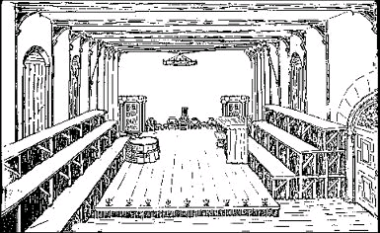
Part of a medieval monastery, the Blackfriars Theater had a roof. Its admission fees were high, and but the indoor theatres attracted wealthier audiences, more socially prominent and better educated than the average playgoer. Smaller than other theaters, with a candle-lit stage, the Blackfriars was considered a "private" theater. In 1576 the hall was rented to Richard Farrant, Master of the Chapel Children at St. Paul’s. The plays of John Lyly were performed there by members of the boys choir. The theatre held special status, standing within the City's walls, but not under its jurisdiction, so the plays’ content could not be censored by the Master of Revels. The picture shows an empty stage set for Lyly's play Campaspe. There are benches for the spectators, doors for the actors at the rear, two "houses" to locate the action, one Diogenes' tub, one Apelles' studio. (Elizabethan Authors)
(Blackfriars 1576 )

Slide 64
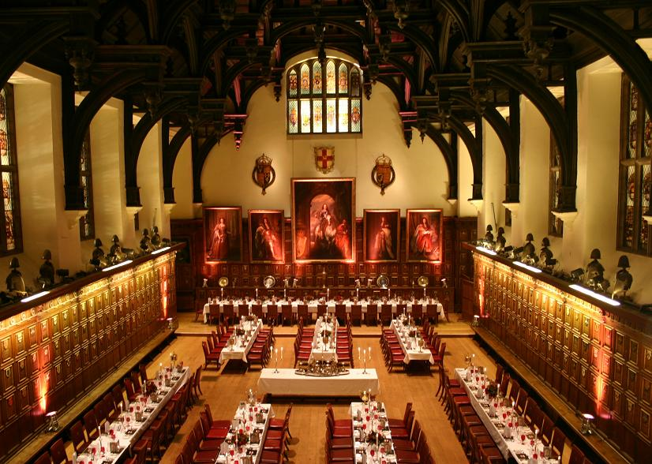
Many early theatre goers hailed from the Inns at Court where students trained for careers in the law. Shakespeare's Comedy of Errors, first staged at the Gray's Inn (1595) by the Lord Chamberlain's Men, was said to have caused a riot. The Middle Temple Hall was the site for the first performance of Twelfth Night in 1602.

Slide 65


Slide 66
Southwark and the Bankside: London’s Pleasure Grounds
Because this borough was in the suburbs, outside the city’s jurisdiction, many forms of illicit entertainment thrived: alehouses , brothels and other "unlawful games," often involving gambling, were played in alehouses: besides dice and tables (backgammon), card games were popular, aided by the spread of cheap printed cards. Too, outdoor games like bowls could be brought within the precinct of the alehouse by the construction of bowling- alleys. There were public gardens and open spaces, baiting rings, and, not least, theaters. A variety of professional entertainers -- acrobats, actors, ballad-singers, bearwards, clowns, fencers, puppeteers -- put on a virtually continuous performance. There were races and open air games, and music and dancing were provided at a reasonable price.
John Evelyn, writing in September 1660, found other attractions of interest:
I saw in Southwark at St. Margaret's Faire monkies and asses dance and do other feates of activity on ye tight rope -- they turn'd heels over head with a basket having eggs in it without breaking any; also with lighted candles in their hands and on their heads without extinguishing them, and with vessels of water without spilling a drop. I also saw an Italian wench daunce and performe all the tricks of ye tight rope to admiration.... Likewise here was a man who tooke up a piece of iron cannon of about 400 lb. weight with the haire of his head onely. (Browner)

Slide 67

Plan of the Bankside, Southwark, in Shakespeare's time

Slide 68

The Rose Theatre and the Bear Baiting Pit From Norden's “Civitas Londini,” 1600

Slide 69

The Rose (1587), built on the Bankside in Southwark by Philip Henslowe and Edward Alleyn became the home of the Lord Admiral’s Men.
Notes:
A History of The Original Rose Theatre
When Henslowe built The Rose Theatre in 1587, he created a space where competing entertainers mingled and mixed. The result was a very unique offering, not repeated by any other Elizabethan playhouse. After all, The Rose was the only playhouse where rival playwrights, Shakespeare and Marlowe both staged plays; not to mention competitors Greene, Kyd, Chapman, Fletcher and Ben Jonson. It was the only theatre to simultaneously house rival companies like The Admiral’s Men, The Lord Strange’s Men, The Queen’s Men and The Worcester’s Men. The Rose was a theatre where – at first – you could even enjoy rival entertainments: bear-baiting, cock-fighting or theatre. The Rose even housed a duel between rival dramatists Ben Jonson and Gabriel Spenser; luckily Jonson survived because he went on to help publish Shakespeare’s plays. Only at court or at The Rose did the Elizabethan audience member have as many choices for entertainment crowded into one place. It was in this vibrant, varied and sometimes vicious environment that William Shakespeare came to prominence as a writer.
In business, location is everything and the land that Henslowe leased to build The Rose was ideally situated. It was located on the Southbank, a short boat ride from the City of London. It was easy to get to for visitors from the city; but it was far enough out to be subject to slightly looser licensing laws. These laws and the more affordable venues meant that the Southbank was already known for entertainment: it was filled with brothels, gaming dens and bull and bear baiting arenas. In addition the area itself was densely populated by people who sought more affordable housing than was available in the city. The location was perfect and Henslowe shrewdly spied an incredible business opportunity.
Henslowe and his partner, John Chalmley, hired the carpenter, John Griggs, to build the theatre in 1587. The building went up within a year and by 1598 it was known around London simply as “The Playhouse;” probably because there were no other theatres in the area. There is a strong possibility that the theatre was also used for animal-baiting during the first year. After all, the amphitheatre was originally built without a stage and the first gallery was seven feet up, high enough so that angry bears couldn’t reach. Then again, this would not explain how the theatre so quickly came to be called “The Playhouse” and it is equally possible that Griggs simply worked from a building design more familiar to him: that of the animal-baiting arena. In fact, not much at all is known about the first five years of “The Playhouse;” it is even possible that Henslowe rented it out to a theatre company and took a well-deserved break.
In 1592, Henslowe began to keep a record of accounts, which he called “Henslowe’s Diary.” This still survives today and provides us with the best account there is of Elizabethan Theatre practices. The diary also reveals how deeply original Henslowe was as a theatre manager in those early days at The Rose. Most managers like Richard Burbage, his son James Burbage or the collective of actors that ran The Worcester’s Men simply dealt with the venues and the plays that their own company used. Not so with Henslowe: even though he managed The Admiral’s Men and built The Rose for this company, he cleverly rented out his playhouse to various different companies. He even rented out his own company’s plays, bartered and swapped play scripts with other companies and made loans to the theatre companies producing at The Rose. As a result, Henslowe made a lot of money and The Rose became a melding pot for competing actors, writers, musicians and playwrights. The power this gave Henslowe also meant that his theatre was one of the only two licensed to perform in 1594, further encouraging rival companies to comingle under Henslowe’s leadership. Only at The Rose could we see The Admiral’s Men performing Shakespeare; or Shakespeare himself acting in The Lord Strange’s production of a Jonson play!
(The building that Henslowe oversaw was also eccentric and original compared to other Elizabethan playhouses. In some ways, the design was typical: The Rose was a fourteen sided polygon made of timber, lather and plaster; the audience could stand in a front pit or sit in the galleries around the edge. The Rose was smaller than The Globe and The Swan, but this simply supports the theory that it was based on earlier bull-baiting arenas. In other ways, however the theatre was truly unique. For one thing, excavations reveal that the stage was shaped like a lozenge, not the more typical thrust shape; this meant that at no point did the actors have their backs to audience members in the pit. The standing-pit itself was raked downwards towards the front of the stage: this was a great idea to help those at the back of the pit to see the play, but it did become problematic whenever rainwater cause a muddy stink at the front of the pit. We think that the stage was also positioned slightly off centre from the audience: this allowed for a central back door entrance, without the central support pillar getting in the way of the actors’ entrance. (The Globe would solve this problem by having two support pillars off to the side of the stage.) Finally, The Rose was also known for its unique ability to house large scenes on the two different levels of the stage: plays like Titus Andronicus made good use of this. )
Henslowe’s brilliance and The Rose’s structural advantages may also have led to the downfall of the playhouse. Perhaps because of the theatre’s unique ability to house crowd-scenes on both levels of the stage, the theatre became known for its grand Histories like Shakespeare’s Titus Andronicus or Peele’s The Battle of Alcazar. These fell out of favor compared to the more light-hearted comedies and more succinct tragedies on offer at The Swan and at The Globe. Henslowe’s power must also have been a motivating factor for companies to found these two rival theatres. Although Henslowe rented out the space to various different companies, he favored his own company The Admiral’s Men. After the plague died down in 1594, The Admiral’s Men took up a more permanent residence at The Rose, prompting Pembrooke’s Men to found The Swan in 1595 and The Queen’s Men to found The Globe in 1599. Henslowe was a ruthless business-man and as soon as The Globe opened on The Southbank, he and his son-in-law Edward Alleyn made arrangements to lease The Fortune, a theatre further north away from the competition. The Fortune was one of the only theatres licensed by The Privy Council in 1600, ensuring Henslowe and Alleyn’s continued success, but perhaps condemning The Rose to failure.
In 1602, the slightly impoverished, slightly worse-for-wear group The Worcester’s Men took up occupation at The Rose. They performed for one more inglorious season before abandoning the theatre to demolition in 1605. In their company was a man called William Kempe, a drunkard and somewhat of a national favorite, Kempe had departed abruptly from Shakespeare’s Company the year before. It is thought that he arrived at The Rose with a smuggled, stolen, cobbled-together copy of Shakespeare’s Merry Wives of Windsor. Certainly, he borrowed money from Henslowe to make a “payer of gyente hosse” or trousers in that same year, suggesting that he may have been reviving – or stealing – the Queen’s Men’s beloved Falstaff.
TIMELINE
1552 – Record of a small residence and two rose gardens called “The Little Rose”.
1585 – Businessman Philip Henslowe and Chef John Chalmley lease The Little Rose.
1587 – Philip Henslowe and John Chalmley sign an eight-year agreement to run a theatre.
Carpenter John Griggs begins building the theatre, known as “The Playhouse”.
1591 – The Admiral’s Men split from Burbage’s company and arrive at The Playhouse.
1592 - Actor, Edward Alleyn marries Philip Henslowe’s daughter Henslowe begins to keep “Henslowe’s Diary” in a small account book Henslowe spends £105 enlarging the theatre into a “flat oval” or “bulging tulip”.
The Lord Strange’s Men arrive at The Playhouse and perform through the year.
Shakespeare’s Henry VI is performed at The Rose by The Admiral’s Men.
1593 - 11,000 people die from the plague, The Playhouse closes for much of the year
1594 – The Playhouse reopens after the plague: Marlowe, Greene and Kyd have died.
The Playhouse and The Fortune are the only playhouses licensed to perform.
The Chamberlain’s Men perform Shakespeare’s Titus Andronicus at The Playhouse.
The Admiral’s Men return and perform at The Playhouse for the next seven years.
1595 – The Swan Theatre is opened nearby.
“The Playhouse” is renamed “The Rose”.
1599 – The Globe opens on The Southbank.
Henslowe, spying the competition takes out a lease for The Fortune.
1600 – Henslowe moves The Admiral’s Men up to The Fortune.
The Privy Council only licenses The Fortune and The Globe to perform.
1602 – The Worcester’s Men revive performances at The Rose.
Shakespeare’s old clown, William Kempe, joins them; possibly with a stolen copy of Shakespeare’s The Merry Wives of Windsor.

Slide 70

The Rose, built by Philip Henslowe in 1587, was the first playhouse on the Bankside. It was home stage for the Admiral's Men from 1594 to 1600. The Rose saw the performances of some of the most famous Elizabethan plays, including Greene's Friar Bacon and Friar Bungay, Thomas Kyd's The Spanish Tragedy, Marlowe's Doctor Faustus, Tamburlaine the Great and The Jew of Malta, as well as Shakespeare's Henry VI, Part 1 and Titus Andronicus. The theatre was probably demolished by 1606. Notice that the stage is relatively small, reaching only about one-third of the way into the "yard". Later theatres had much larger stages. (Shakespeare’s Life and Times)
Notes:
At this time, The Rose underwent some remodelling allowing it to hold larger audiences. The Rose saw the performances of some of the most famous Elizabethan plays, including Greene's Friar Bacon and Friar Bungay, Thomas Kyd's The Spanish Tragedy, Marlowe's Doctor Faustus, Tamburlaine the Great and The Jew of Malta, as well as Shakespeare's Henry VI, Part 1 and Titus Andronicus.

Slide 71

Christopher Marlowe seems in many ways to be Shakespeare’s twin: he had been born in the same year (1564) and was the son of a commoner, a Canterbury shoemaker. He had also been a brilliant grammar school student, only Marlowe had been given the opportunity to go to Cambridge that Shakespeare had been denied. In the late 1580’s Marlowe electrified the London stage with a production for the Lord Admiral’s Men at the Rose Theatre on the Southbank that he had written as a college student: Tamburlaine the Great. He followed this hit with three more in quick succession: The Jew of Malta, Dr. Faustus and Edward II. His ‘mighty line’ inspired Shakespeare to be a playwright. (Greenblatt)
Notes:
By 1594, the Admiral’s men had severed their connection with Strange’s (then the Chamberlain’s) company, and started independently at the Rose with Alleyn as their leading actor. Barabas, in Marlowe’s Jew of Malta, Tamburlaine and Dr. Faustus were among the parts he created and it is probable, also, that Orlando Furioso in Greene’s play of that name was in his répertoire.

Slide 72

It can be argued that Marlowe invented the new form of drama that Shakespeare would perfect. Tamburlaine the Great was one of the most successful plays of the Elizabethan era. The plot tells the story of a commoner, a Scythian shepherd, who through charisma and ruthlessness rises to the throne of the mightiest empire in Asia. It combined theatrical spectacle with an outrageous plot and magnificent poetry, and it inspired admiration, awe and horror in its audience. London’s urban audience, thronged by apprentices on the make, thrilled to this “anti-morality play”.
Richard Scher as Tamburlaine The Great (1993) RSC

Slide 73

Holla, ye pampered Jades of Asia:
What, can ye draw but twenty miles a day,
And have so proud a chariot at your heeles,
And such a Coachman as great Tamburlaine?
But from Asphaltis, where I conquer'd you,
To Byron here where thus I honor you?
The horse that guide the golden eie of heaven,
And blow the morning from their nosterils,
Making their fiery gate above the cloudes,
Are not so honoured in their Governour,
As you (ye slaves) in mighty Tamburlain.
from Marlowe’s Tamburlaine the Great

Slide 74

In this early woodcut of Marlowe's play Dr. Faustus, Mephistophilis appears for the first time to the professor, who is standing in a magic circle for protection. The picture is not specifically of a stage performance, but the appearance of the Devil from below suggests a trapdoor; Faustus' costume, and the other properties may also have been used on stage. (Shakespeare’s Life and Times)

Slide 75

Edward Alleyn was the leading player in the Admiral's Men, and was considered by many to have been the greatest actor of his time. His credits include the title roles in Tamburlaine and Dr. Faustus, and Barabas in The Jew of Malta. In 1592 he married Phillip Henslowe's stepdaughter, Joan, and formed a profitable business relationship with his father-in- law. Alleyn retired from acting in 1604 to pursue his business interests. When his wife died in 1623, he married John Donne's daughter, Constance. Alleyn died three years later, on Christmas Day. (Shakespeare’s Life and Times)

Slide 76

Hieronimo, the hero of The Spanish Tragedy, finds his son Horatio murdered, hanging in an arbor. A major hit in 1587, performed throughout the next fifty years, The Spanish Tragedy is the first major example of the revenge plot in English drama.

Slide 77
Shakespeare’s Rise in the London Theatre World
We know nothing of Shakespeare’s life from the time he left Stratford until the first documented mention of him as a playwright in London in 1592. Yet by 1594 his company had been selected by the Master of Revels to be one of the two officially recognized troupes in the city. Not only did the Lord Chamberlain’s Men perform regularly at court, but Elizabeth gave them a virtual monopoly over the London theatre market, with their chief rivals the Lord Admiral’s Men,.
Careful study of Shakespeare’s early works can help us theorize about how he rose so quickly to the pinnacle of the London theatre world. In a pamphlet published in 1592; a university wit named Robert Greene lambasted an up and coming writer/actor who had infuriated some on the London theatre scene:
"Yes, trust them not, for there is an upstart crow, beautified with our feathers, that, with his Tygers heart wrapt in a Players hide, supposes he is as well able to bumbast out a blanke verse as the best of you; and being an absolute Johannes Factotum, is in his owne conceit the onely Shake-scene in a countrie." (Greene’s Groatsworth of Wit)

Slide 78
Shakespeare’s Rise in the London Theatre World
Shakespeare had not attended Oxford or Cambridge. He did not possess the appropriate intellectual pedigree, being little more than a country provincial from Stratford. Greene accuses him of being a hanger-on who thieves (or plagiarizes) from his betters: an upstart who dresses like a nightingale yet caws like a crow, who supposes that he can bombast out a blank verse like his betters. Greene calls Shakespeare a Johannes Factotum, a Jack-Of-All-Trades. He is paying Shakespeare a backhanded compliment by recognizing his skill as an actor, playwright, and businessman. Shakespeare had learned the business of playing from the inside as a professional, not as a member of any elite university intellectual circle. His training was in theatre, not poetry. And by accusing him of plagiarism (in an era long before copywrite had any meaning), Greene may also have recognized another of Shakespeare’s special talents. He ruthlessly plundered the work of other writers and turned their ideas into better theatre than they could imagine.
The playwright from whom Shakespeare learned (and robbed) most in the early years of his career was Christopher Marlowe. He and Marlowe may have collaborated on the patriotic, hugely popular Henry VI play cycle which celebrated the rise of the Tudor dynasty at the end of the War of the Roses. In the late 1580’s London was celebrating the recent defeat of the Spanish armada. (Greenblatt 213-16)

Slide 79

Shakespeare’s Rise in the London Theatre World
Image from Henry VI, Hall/Bury, Royal Shakespeare Company, July 1963

Slide 80

Henry V, Kenneth Branagh film (1989)

Slide 81

Henry V, Kenneth Branagh film (1989)

Slide 82

Shakespeare also exploited the vogue for Senecan tragedy in the blood drenched Titus Andronicus, a spectacle of cruelty in which he tried to out do Marlowe’s model in Tamburlaine and The Jew of Malta.
Henry Peacham made this sketch of a scene from Shakespeare’s Titus Andronicus in 1595. Note that Titus (holding the spear) is in a Roman toga, while Tamora, queen of the Goths, wears Elizabethan dress, as do the soldiers behind Titus. We know acting companies used elaborate costumes, but this drawing suggests that performances did not strive for historical accuracy. The figure on the right is the play’s villain, Aaron the Moor. Peacham’s drawing suggests he was represented as black. For a close-up, see the next image. (Mt. Holyoke)

Slide 83


Slide 84


Titus Andronicus, Shakespeare’s Globe 2007

Slide 85

Experimenting in a variety of comic genres, Shakespeare shows off his skill at language and plotting at every opportunity. In The Comedy of Errors, Shakespeare takes the Roman playwright Plautus’ comedy about a pair of twin servants at large in the same city and makes it into a truly nightmarish farce by making their masters twins as well, thus multiplying the opportunities for mistaken identity and farce.
On December 28, 1594 the Lord Chamberlain's Men performed The Comedy of Errors at Gray's Inn as part of the Christmas "law revels.“ Because the crowd was large and unruly, it was "thought good not to offer any thing of Account, saving Dancing and Revelling with Gentlewomen... [and] a Comedy of Errors... [which] was played by the Players." (Internet Shakespeare)
Image from The Comedy of Errors, Shakespeare’s Globe 2006

Slide 86

Will Kempe was the clown of the Lord Chamberlain’s men, an original sharer in the company. Cut in Richard Tarleton’s mould, Kempe’s stage act featured lightning wit, facility with rhyming doggerel, and skill with dancing and fencing. In the earlier, commedia inspired era of English comedy, major sections of the performance were set aside for the reigning comic to play the audience. The clown led the jig which concluded each show, not just with dance, but a short, bawdy skit including song with improvised lyrics to a familiar folk tune.
Launce and Crab from The Two Gentlemen of Verona, JamesTaylor/Doidge, Young Vic, February 1975

Slide 87

In Love’s Labour’s Lost, Shakespeare mocked the London vogue for Petrarchan sonneteering which had reached its height in the late 1580’s. In this play, four young men, have sworn off romance to devote their lives to ‘truth’, but they fall for four visiting princesses from France. Shakespeare's boisterous send-up of all those who try to turn their back on life is a festive parade of every weapon in the youthful playwright's comic arsenal: from excruciating cross-purposes and impersonations, to drunkenness, bust-ups and pratfalls. Even more, it is a joyful banquet of language, groaning with puns, rhymes, bizarre syntax, grotesque coinages and parodies. (Globe Education)
Image from Loves Labour’s Lost, Shakespeare’s Globe 2007

Slide 88

In 1599, the popular clown Will Kempe, a share holding member of the Lord Chamberlain’s Men since its inception, left the company, perhaps at Shakespeare’s instigation. Perhaps the playwright had grown tired of Kempe’s improvisations and bawdy jigs. In response, Kempe proceeded to dance a jig from London to the sea. In Hamlet, written during Shakespeare’s first year at the Globe, the Fool Yorick is dead. For his next comedy, As You Like It, Shakespeare hired a new type of clown , the witty riddler and great singer, Robert Armin. (Shapiro)

Slide 89

The diminutive Robert Armin joined the Chamberlain's Men in 1599. He was a master of extemporaneous versifying, a subtle comic, an accomplished singer, and a playwright himself.. He would play Touchstone, in As You Like It, Feste in Twelfth Night, the Gravedigger in Hamlet, the Porter in Macbeth, and the Fool in King Lear.

Slide 90

Shakespeare wrote his first masterpieces in the mid-1590’s. Romeo and Juliet proved not only to be a hit in Elizabethan London, but it remains the most popular love story of all time. In it Shakespeare found the theme that would inform all of his tragedies: the transforming passions which make mortals into gods but destroy them in the process. In Romeo and Juliet the lovers achieve perfect joy, but only at the price of their lives.
Image from Romeo and Juliet, Leveaux/Chitty, Royal Shakespeare Company, August 1991

Slide 91

Image from Romeo and Juliet, Nunn/Dyer, Royal Shakespeare Company, March 1976

Slide 92

Closely related in theme, A Midsummer Night’s Dream explores the same harrowing realm of unchecked passion, but the conventions of comedy allow a happy ending. Two pairs of lovers elope from Athens only to find themselves lost in an enchanted forest where impish spirits use love charms to manipulate the object of their affections. The Queen of the Fairies herself, Titania, succumbs to the drug and falls in love with Bottom the Weaver, who has been transformed into an ass.
A Midsummer Night's Dream Toronto 2008

Slide 93

A Midsummer Night's Dream, 1989, directed by John Caird, designed by Sue Blane. The photograph shows Puck (Richard McCabe, left) and Oberon (John Carlisle, right).

Slide 94

A Midsummer Night's Dream, 1989, directed by John Caird, designed by Sue Blane. The photograph shows Bottom (David Troughton) and Titania (Clare Higgins), Act 4 Scene 1.

Slide 95

The Swan Theatre (1595), was built by Samuel Langley, a man apparently with both political and underworld affiliations. The only play to known have been performed here was the ill fated Isle of Dogs by Thomas Nashe, a political fiasco that resulted in closing of all the theaters. When the theaters were reopened, Langley had difficulty in recruiting other companies. (Elizabethan Authors)
Notes:
The first known mention of a William Shakespeare's connection to London arises in connection with Langley' feud with William Gardiner, a judge and
real estate speculator with a history of criminal activity. In 1596 Langley sought court protection against Gardiner and his stepson William Wayte; and Wayte then sought the same protection against Langley, William Shakespeare, and two women named without a courtesy title, seemingly of rather low character. Discovered by Leslie Hotson, the record is a curiosity: placing Shakespeare with the wrong person at the wrong theater at the wrong time;
although it does connect him to real estate speculation, an activity that was
to mark his financial activities to the end of his days in Stratford.
http://www.elizabethanauthors.com/theater1.htm

Slide 96

This sketch of the Swan is the most complete we have of any theatre of the time. The Swan was built in 1596; in the same year, Shakespeare's Company, the Chamberlain's Men, played there. A foreign visitor described a circular building with three stories of seats, each containing three rows, overlooking an unroofed central area into which a stage thrusts. The stage was half covered by a canopy extending from the rear wall and supported by massive columns on stage. Two doors stood in the back wall of the stage, with box seats above the doors. At the top of the rear structure was a roofed hut, from which a flag flew and trumpets were blown to announce that a play’s beginning. (Shakespeare’s Life and Times)
De Witt's sketch of The Swan 1596
Notes:
The Swan Theatre
From Visscher's View of London, 1616
Francis Langley, a petty court official, purchased the manor of Paris Garden in 1589. The first mention of the Swan is in 1594, when the Lord Mayor protested against plans to build a playhouse on the property. An exact date of construction is not known (1595-96?), the first certain record being from February 1597, when Pembroke's Men contracted to play there. Theatrically, the history of the Swan theatre is unimpressive. The Swan's contemporary claim to fame or, in this case, infamy, was the outrage that erupted over the performance of The Isle of Dogs in 1597. The play was deemed so seditious by the authorities that the play was banned, arrest warrants were drawn up for everyone involved, and all London theatres were closed down for months. It seems the Swan never quite recovered from the scandal. The Swan was used for plays until 1620, was still standing in 1632, and may have survived until c.1637.
The real importance of the Swan in the history of English Renaissance theatre is due to a drawing made by a visiting Dutchman, Johannes (John) de Witt, c.1596. The sketch, surviving only in an early copy by de Witt's friend, Arend van Buchell, is of the interior of the Swan Theatre. It is the only extant contemporary representation of the interior of an Elizabethan public playhouse, and as such is invaluable to the study of Elizabethan theatre. Some details of the drawing have been a matter of much controversy with scholars (cf. appended resources), but the drawing and accompanying description do give a general idea of the interior of an Elizabethan theatre.

Slide 97

The Globe 1599
In 1599 the deal fell through for the Lord Chamberlain’s Men to move to the Blackfriars Theatre (due to the complaints of aristocratic neighbors). So the Burbage brothers had to move quickly to secure another performing venue. Their lease for the land on which The Theatre in Shoreditch was standing had expired, but the players reasoned that the actual building still belonged to them. So the company disassembled the whole structure and reassembled it on land on the Bankside in Southwark, just south of the Thames and east of the London Bridge. The lease was held by Richard Burbage (sharing in 1/2 of the building) and company members John Heminge, Will Kemp, Augustine Phillips, Thomas Pope, and William Shakespeare.
Notes:
This view of the first Globe by the Dutch engraver J.C. Visscher was printed in 1625, but must be taken from an earlier drawing, since the first Globe was burned to the ground in 1613 at the first performance of Shakespeare's Henry VIII. There is substantial evidence that Visscher simplified the appearance of the theatre by portraying it as octagonal: most scholars now believe that it had twenty sides, thus making it seem more circular than in this engraving. Shakespeare's Life and Times

Slide 98


Slide 99

Long View of London from Bankside, 1647, Wenceslaus Hollar (detail)

Slide 100

Globe Theatre 2006

Slide 101


Slide 102


Slide 103

At the Globe you could come into the presence of the nobility and shout abuse at them, if you dared.

Slide 104
Elizabethan Economic Values
1 penny = entrance to an amphitheatre as groundling
2 pennies = entrance to amphitheatre galleries
1 penny = one quart of beer
1 penny = four oranges
1 penny = two eggs
1 penny = ½ lb. Beef
6 pennies = one roasting pig
12 pennies = one shilling
12 shillings = one lb. of tobacco
6-8 shillings = artisan’s pay for a seventy hour week
20 shillings = one pound = 240 pence
10 pounds = typical average income for schoolmaster
17 pounds = artisan’s income for year
600 pounds = barrister’s income for year
Attendance at amphitheatres ranged from under 600 to over 2000. per performance. 15,000 people attended Elizabethan theatres each week in 1595. That number had risen to 21,000 by 1605 (13% of London population) (Thomson)

Slide 105
Amphitheatre Income
Theatre owners, like Philip Henslowe at the Rose, were entitled to take half the income from the two penny galleries.
The income for a typical performance ranged between 25 and 50 shillings, over 60 shillings for a full house. So the audience for the galleries ranged between 150 and 300 people per show .
Income for a good week would be as high as 16 pounds, but that happened only rarely at the Rose. Henslowe only broke 10 pounds twelve times between 1598 and 1600.
The actors took the other half of the gallery income plus the income from the yard of groundlings. A company’s typical take was about 3 pounds. A successful actor would make about 30 pounds a year. An apprentice actor would make about five shillings a week. (Thomson)

Slide 106
Shakespeare’s Fortune
Shakespeare belonged to a joint stock company at the Globe, which meant that he and the other share owners were entitled to their cut from one half of the gallery receipts plus their cut from the rest of the income as actors.
Shakespeare’s annual income from the Globe alone between 1599 and 1608 may be conservatively estimated at 55 pounds. That makes no allowance for any special payments he may have received for writing the plays. By 1597 Shakespeare had saved enough to purchase New Place, the second largest house in Stratford, for 60 pounds. By1602 he could afford to pay 320 pounds for land in Old Stratford, and then three years later he could also afford to pay 440 pounds for an interest in the share of tithes in and around Stratford.
When Shakespeare went into semi-retirement in 1608, he also owned a housekeeper share in the Blackfriars, which would have brought his average annual theatrical income to over 200 pounds.
Shakespeare had made a career for himself as an actor, but he was one of the creators of the profession of playwright. (Thomson)

Slide 107


Slide 108

Thomas Platter, who saw Julius Caesar performed at the Globe, described the Bankside theaters:
daily at two in the afternoon, London has two, sometimes three plays running in different places, competing with each other, and those which play best obtain most spectators. The playhouses are so constructed that they play on a raised platform, so that everyone has a good view. There are different galleries and places, however, where the seating is better and more comfortable and therefore more expensive.... And during the performance food and drink are carried round the audience, so that for what one cares to pay one may also have refreshment. (Browner)

Slide 109

f. GROUND n. + -LING. Cf. MDu. grundelinck (Du. grondeling), MHG. grundelinc (G. gründling) gudgeon.]
A name given to various small fishes which live at the bottom of the water
AKA BOTTOM FEEDER

Slide 110

Playgoers in Elizabethan London
Audiences at the public amphitheatres contained persons of almost every social type from low-born gulls and vagabonds, cutpurses, and harlots, to raffish upper-class punters and courtiers. Not watchful silence but rather active and vocal participation was the usual audience reaction to a play that caught their interest. If it turned out to be a bad play, this was likely to take the form of hissing and pelting the unfortunate actors with oranges. During an indifferent play, however, the audience diverted itself with a variety of activities ranging from dicing and card-playing -- sometimes on the stage itself -- to swearing, spitting, munching apples, cracking nuts, making passes at the women, and, for some, cutting purses. (Browner) To the right is Moll Cutpurse, a notorious cross dressing thief who achieved celebrity as a theatergoer at the Globe. She inspired Thomas Middleto n’s play, The Roaring Girl
Moll Cutpurse

Slide 111


Slide 112


Slide 113

The Heavens
The Earth
Nobles
Commons
Underworld
The Groundlings
The Globe Stage

Slide 114

The move to the Globe gave Shakespeare the opportunity to write for a new audience and dispense with the obligation to present the improvisational clowning and raucous jigs expected on the stage of The Theatre or The Curtain. Shakespeare seemed determined to move beyond the bombast and bloody spectacle which had typified his early Marlovian tragedies. At the Globe Shakespeare would develop the art of ‘personation’ to a degree which had never been seen before on the stage. In Julius Caesar Shakespeare’s hero is Brutus, the conspirator of conscience. In As You Like It, his heroine is Rosalind, a lover who dismisses the flowery similes of the Petrarchan tradition. Shakespeare had discovered how to suggest the interior depths of character with compelling symbol, thereby engaging the audience in his goal of representing the complexity of our inner psychology on stage. (Shapiro)
As You Like It, 1980, directed by Terry Hands, designed by Farrah. Rosalind (Susan Fleetwood).

Slide 115

Gestating in Shakespeare’s imagination were the great characters he would create on the Globe’s stage in the next, most extraordinary period of his career as a playwright. In Hamlet, Shakespeare reimagined the revenge tragedy as a psychological mystery, not a drama of intrigue. In Othello Shakespeare exposes the roots of racism and sexism in the illusion of true love. In Macbeth Shakespeare suggests the terrible depth of our capacity for sin, and in King Lear, illusions are stripped to reveal the horrors and follies of old age.
At the Globe Shakespeare would exploit the talents of an acting troupe with whom he had been working regularly for ten years. The Lord Chamberlain’s Men was led by Richard Burbage who originated Shakespeare’s greatest roles. Shakespeare also succeeded in creating a repertory of stage shows that would dominate the London stage for the next forty years.
Richard Burbage

Slide 116


Slide 117


Slide 118

Ian McKellan and Judi Dench in Macbeth RSC 1976

Slide 119

Willard White and Ian McKellan in Othello at the RSC (1989)

Slide 120

Ian McKellen and William Gaunt in RSC King Lear (2007)

Slide 121

The Lord Chamberlain’s Men’s gamble paid off because the company was able to afford to purchase a second playhouse in which to play during the winter months. In 1608 the Blackfriars was leased and then refurbished by the King's Men through a syndicate consisting of the Burbage brothers, Shakespeare, John Heminge and Henry Condell (the two actors who produced the First Folio), William Sly and Thomas Evans. Like the earlier Blackfriars theatre, it was technically within the city, but the area was a "liberty," not under the jurisdiction of the puritanical city authorities. (Shakespeare’s Life and Times)
The Blackfriars Refurbished 1608

Slide 122

Music sets a mood in many of Shakespeare's plays, both comedies and tragedies. Music on the lute, recorder, or viol was courtly, refined: Hamlet calls for a recorder to put Rosencrantz and Guildenstern in their place Oboes (hautboys) were more mysterious, like their ancestor, the older shawm, which was a rustic instrument by Shakespeare's time; in Beaumont's play The Knight of the Burning Pestle, the boorish Citizen scorns the recorders that provide refined music, and calls for the band of shawms ("waits") of the neighbouring Southwark district. The trumpet, drum and fife were warlike and royal. Trumpet "sennets" sounded to announce the king; and Benedick is horrified by Claudio's change in taste in music as he changes from soldier to lover*. (Shakespeare’s Life and Times)

Slide 123

Funerary picture of Sir Henry Unton (or Umpton) who died in 1596. The original hangs in the National Portrait Gallery in London. (Elizabethan Musicians)

Slide 124

Image from The Winter's Tale, Hands/Howland, Royal Shakespeare Company, April 1986

Slide 125

Image from The Winter's Tale, Alfreds/Dart, Method and Madness, June 1997

Slide 126

Image from The Winter's Tale, Nunn/Morley, Royal Shakespeare Company, May 1969

Slide 127

Image from The Tempest, Daniels/Bjornson, Royal Shakespeare Company, August 1982

Slide 128

Image from The Tempest, Daniels/Bjornson, Royal Shakespeare Company, August 1982

Slide 129


Images from The Tempest, Udovicki&Carroll/Ursulov, May 2000

Slide 130

Jasper Britton as Caliban in The Tempest (2000) Shakespeare’s Globe

Slide 132

Social Precedence
Just as the universe was organized in a strict hierarchy, so society was organized according to strict ranking. Your costume, your seat at the table, your place in the world was ordered. Among the peerage, Dukes before Marquise, then the Earl, Viscount, Baron. Knights were invited to the party, too, despite their common origins.
Notes:
England's social structure was hierarchical. Movement within the hierarchy was accepted (provided it was not too rapid), but there were clear social distinctions that it was thought dangerous to undermine.

Slide 133

Precedence and Costume
Elizabethan preoccupation with social rank extended to the details of daily dress:
When you accepted a job with a noble patron, you actually wore ‘his livery’ and a visible symbol of your precise rank in his household.
Robert Devereux, 2nd Earl of Essex by Marcus Gheerarts the Younger, c.1596

Slide 134
Elizabethan Sumptuary Laws
None shall wear any cloth of gold, tissue, nor fur of sables: except duchesses, marquises, and countesses in their gowns, kirtles, partlets, and sleeves; cloth of gold, silver, tinseled satin, silk, or cloth mixed or embroidered with gold or silver or pearl, saving silk mixed with gold or silver in linings of cowls, partlets, and sleeves: except all degrees above viscountesses, and viscountesses, baronesses, and other personages of like degrees in their kirtles and sleeves.
Enforcing Statutes of Apparel
[Greenwich, 15 June 1574, 16 Elizabeth I]
Notes:
In Elizabethan England, these laws attempted to restrict the sumptuousness of dress in order to curb extravagance, protect fortunes, and make clear the necessary and appropriate distinctions between levels of society.

Slide 135

Black Satin
Black satin, in particular, designated the highest reaches of the social ladder. Black satin was the most expensive because the silk needed to undergo an extensive dyeing process.
"The Ermine Portrait"
Painted in 1585 by Nicholas Hilliard

Slide 136

Perhaps a more accurate portrait of Elizabeth.
Elizabeth I
Painted by John Bettes the Younger
Hever Castle, Kent
Notes:
What she really looked like

Slide 137


Sir Martin Frobisher by Cornelius Ketel, 1577
Lady Diana Cecil by William Larkin, c.1614-18

Slide 138

An unknown lady attrib. to William Segar, c.1595

Slide 139

Henry Wriothesley, 3rd Earl of Southampton by an unknown artist, c.1600

Slide 140
Works Cited
“A guide for Cuntrey men In the famous Cittey of LONDON by the helpe of wich plot they shall be able to know how farr it is to any Street....” Web. 19 Dec 2009.
“A Plan for Rebuilding the CITY after the fire Design'd by that Great Architect SR CHRISTOPHR WREN and approv'd of by King and PARLIAMENT.” Web. 19 Dec 2009.
“bankside.jpg (JPEG Image, 937x571 pixels) - Scaled (71%).” Web. 19 Dec 2009.
“Elizabethan Authors - London Theaters.” Web. 19 Dec 2009.
“Elizabethan Crime and Punishment.” Web. 19 Dec 2009.

Slide 141
“JSTOR: Shakespeare Quarterly, Vol. 44, No. 2 (Summer, 1993), pp. 202-227.” Web. 19 Dec 2009.
“Luminarium Encyclopedia: Visscher's Panoramic View of London, 1616 [Historical Map].” Web. 19 Dec 2009.
“may day... - lancashire's MySpace Blog |.” Web. 19 Dec 2009.
“Mystery play - Wikipedia, the free encyclopedia.” Web. 19 Dec 2009.
“Piccolo Theatre Ensemble Commedia dell'arte Resources.” Web. 19 Dec 2009.
“Ralph Roister Doister.” Web. 19 Dec 2009.

Slide 142
“Renaissance English Drama: From Medieval to Renaissance..” Web. 19 Dec 2009.
“Richard Tarlton - Wikipedia, the free encyclopedia.” Web. 19 Dec 2009.
“SQM-History-About the QM.” Web. 19 Dec 2009.
“Stronghold 2 Heaven: Vernacular Drama of the Middle Ages.” Web. 19 Dec 2009.
“The Rose.” Web. 19 Dec 2009.
“The+execution+of+Guy+Fawkes'+(Guy+Fawkes)+by+Claes+(Nicolaes)+Jansz+Visscher.jpg (JPEG Image, 2400x1690 pixels) - Scaled (30%).” Web. 19 Dec 2009.

Slide 143
“Titus.” Web. 19 Dec 2009.
“Twelfth Night (holiday) - Wikipedia, the free encyclopedia.” Web. 19 Dec 2009.
“Wrong Side of the River: London's disreputable South Bank in the sixteenth and seventeenth century. Jessica A. Browner.” Web. 19 Dec 2009.

Slide 144
Jokinen, Anniina. Renaissance English Drama: From Medieval to Renaissance
Shakespeare's Life and Times
Wrong Side of the River: London's disreputable South Bank in the sixteenth and seventeenth century.

