Slide 1
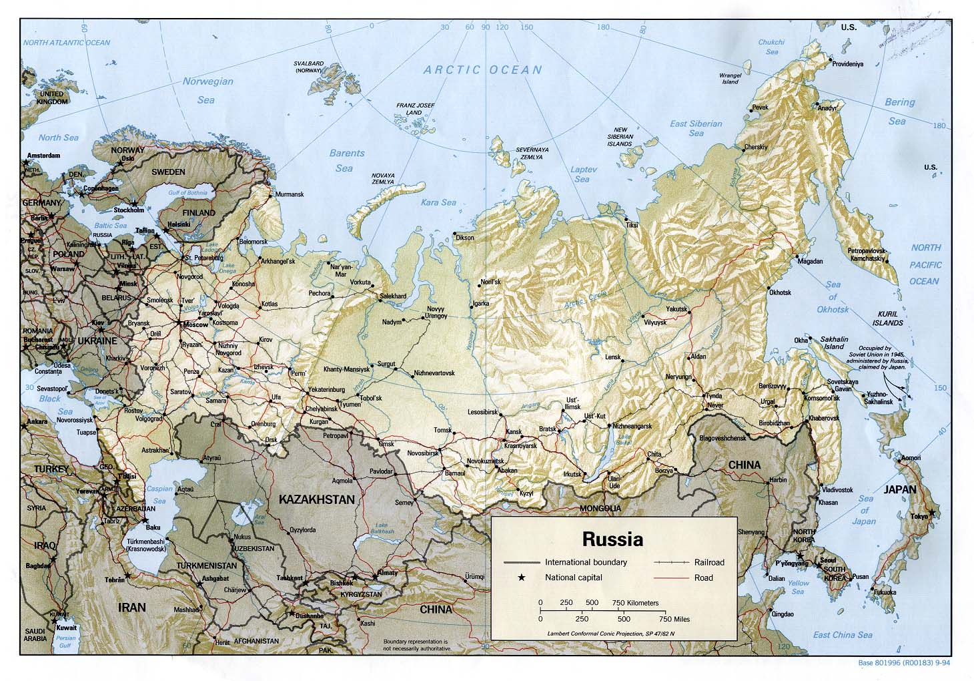

Slide 2
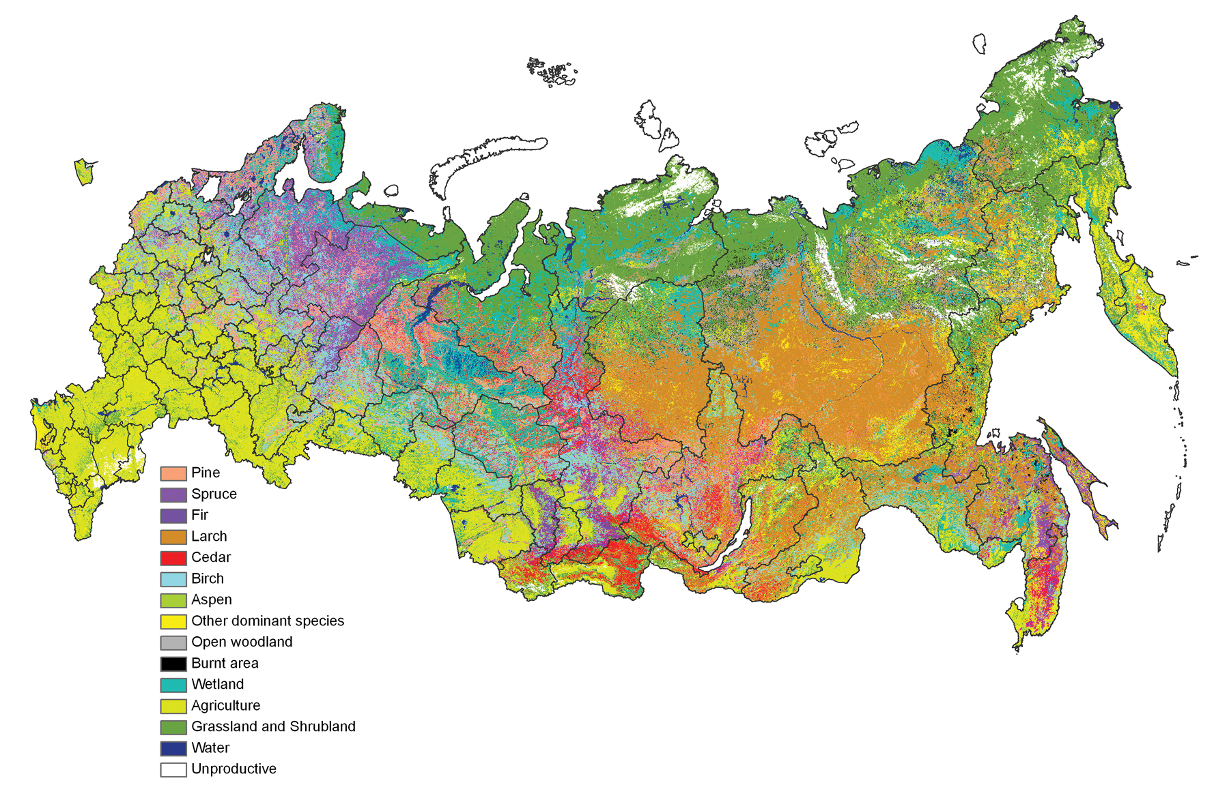

Slide 3
Geography is Destiny: the impact of a harsh climate on social structures:
Inefficient agriculture
  Only 10.8% of the land is arable.
    Permafrost: only top 16” will thaw, creates a swamp
    Pine Forest: acidic soil (Ukraine has most fertile lands)
    Temperature extremes; little precipitation
    Brief growing season
    No mountains to block east/west prevailing winds
  No fertilizer, no seeds, no modern equipment
  Despite hard work of the peasants, the government must import food to feed its people.

Slide 4
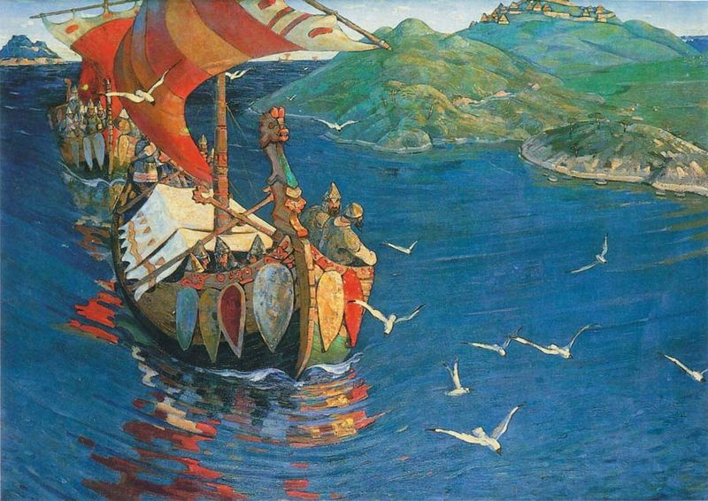
Rurik: the Legendary Norse Founder of Kievan Rus (862)

Slide 5
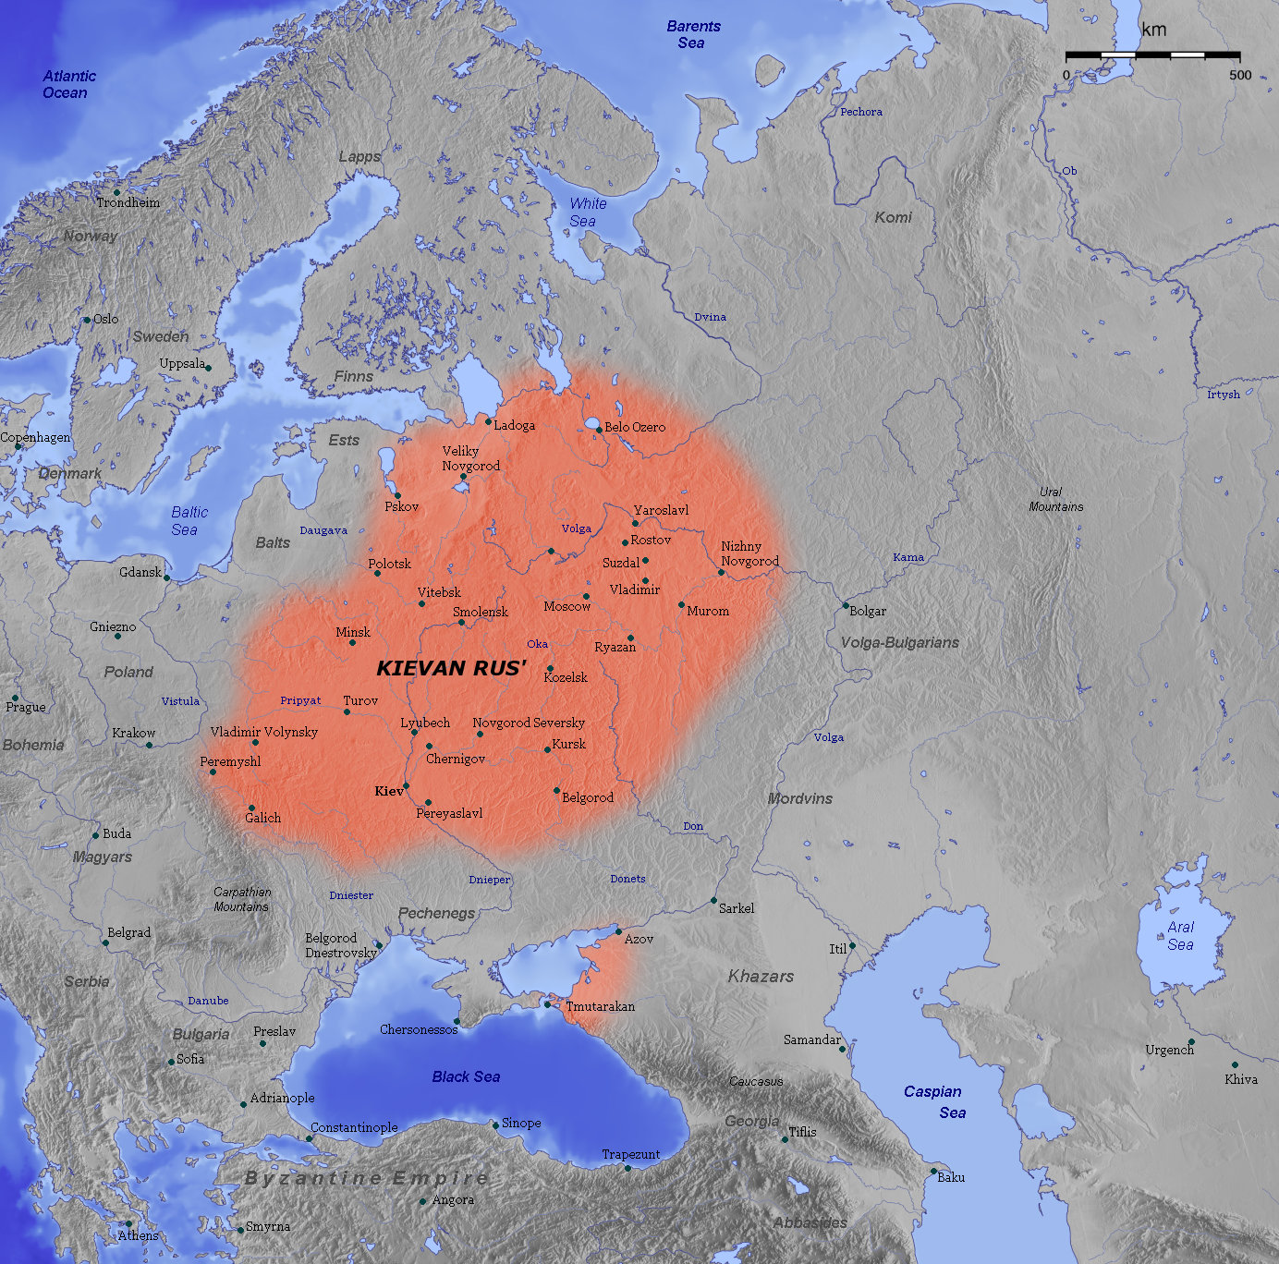

Slide 6
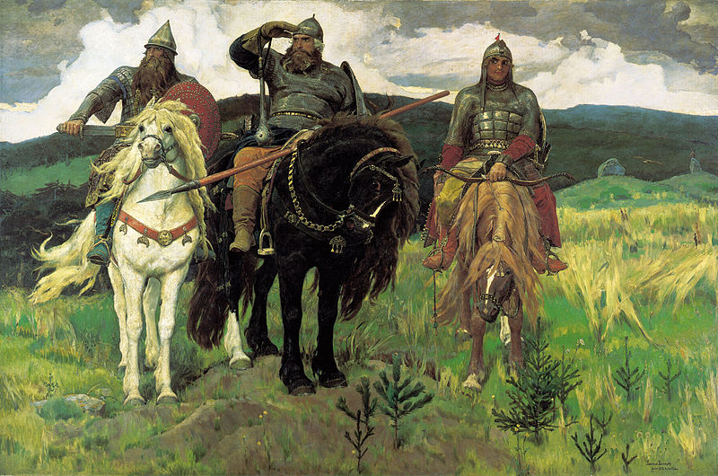
Ilya Muromets: Legendary Kievan Rus Hero
Heroes (1898) aka Bogatyrs (1898) portrait of Dobrynya Nikitich, Ilya Muromets and Alyosha Popovich

Slide 7
Kievan Rus:
Economy: Manorial + Commercial
  Obshchina (mir): peasant communes
Social Structure:
  Princes, Boyars, Merchants, Artisans,
    Smerdy (free, but dependent), Semi-Free Peasants, Slaves
Political Systems: Feudal?
  Monarchical (Prince), Oligarchical (boyar duma), & “Democratic” (veche)

Slide 8
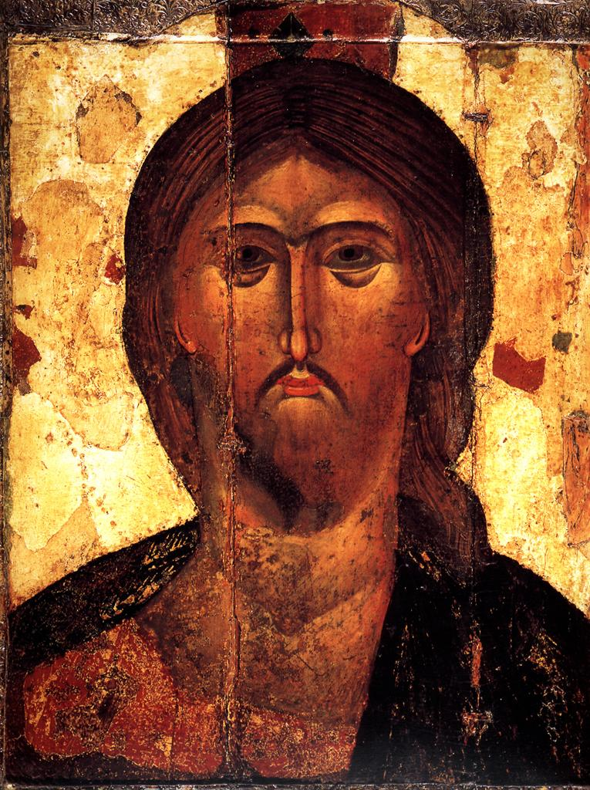
Conversion to Christianity
  Orthodox Christianity selected by Prince Vladimir of Kiev between 980 and 1015
  Byzantine Architecture
  Byzantine alphabet
  Tradition of icon painting
Ancient Jewish Culture
  Jewish communities on eastern shores of Black Sea
  Perhaps Eastern Europe’s Jews were descended from them and not from Israel.

Slide 9
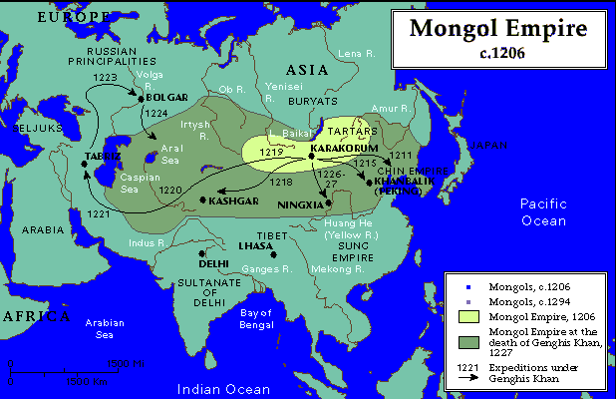
Mongol Conquest (1247)

Slide 10
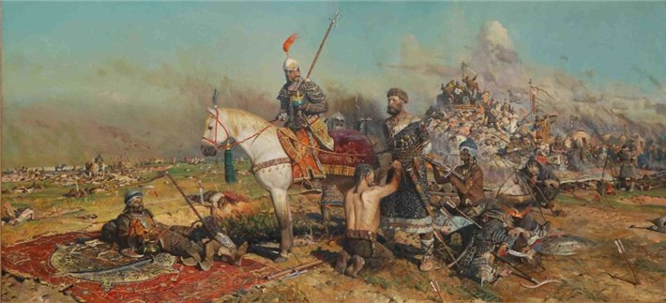

Slide 11
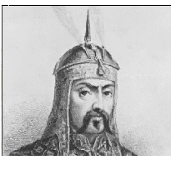
Impact of Mongol Rule (1247-1462)
  Mongol Invasion: important in the establishment of autocratic rule and the centralization of power in Moscow
  No Renaissance in Russia
  Mongol Khans authorize Russian Princes to rule lands for them. They are only interested in payment in tribute and soldiers.
  The Tartars become the enforcers for Russian Princes.
  Moscow Princes are helped by the Tartars to put down rival princes, and then they came to imitate the Mongol Khans in their absolute rule as Tsars.
  The Byzantine Church becomes the propaganda arm of the state.
  Frontier Mentality: Armed forces are needed to protect the frontiers from future invasions; this requires the militarization of the state.

Slide 12
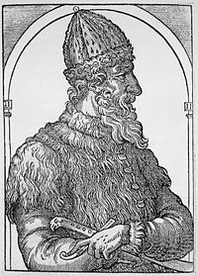
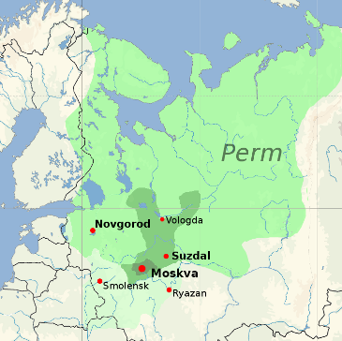
Muscovite Rule (1462-1584)
Mongol liberation/Slav consolidation: Moscow becomes the center of Russia
Ivan the Terrible: Livonian Wars against the Poles and Swedes for Baltic States
Resistance to Autocracy:
Boyar Duma- highest ranking noble families form a ‘senate’, a deliberative body to advise the tsar
Zemsky Sobor- “from the land” an assembly of different classes from all the lands
Mestnicestvo- Tsar grants government jobs to most ancient and powerful families: the first nomenklatura. Nobles desire for power thus channeled and controlled
Votchina- Nobles in the Kievan System owned land on the basis of heredity. That system was replaced by a new feudal system in which a family owned land as long as it pleased the state

Slide 13
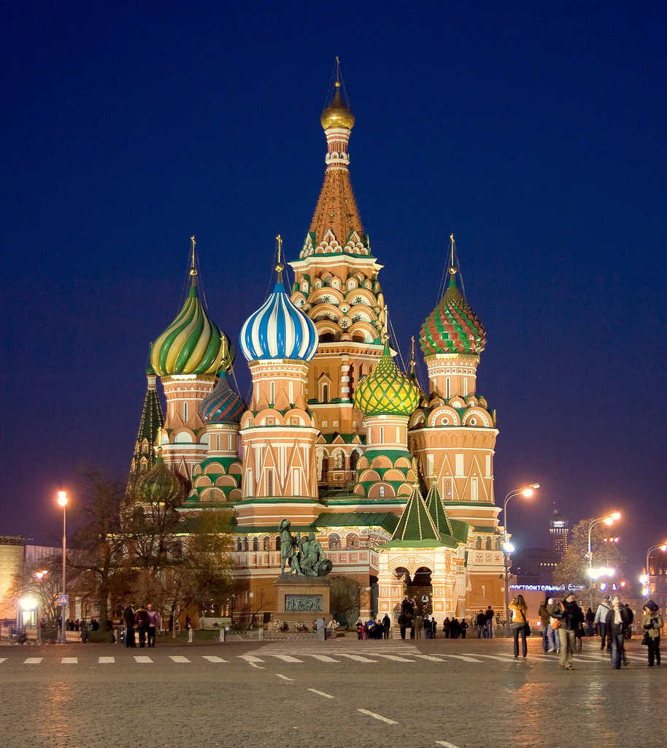
Russo-Kazan Wars (1438- 1552)
St Basil’s in Red Square completed in 1560 commemorates the capture of Kazan and Astrakhan

Slide 14
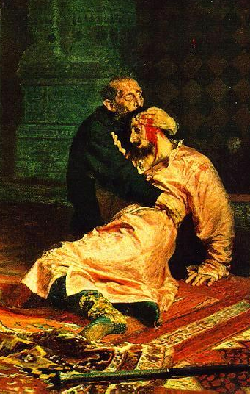
Time of Troubles (1584-1613)
Ivan the Terrible dies. Having brained his heir, Ivan leaves dimwit Feodor to take the throne.
Boris Gudonov, rules as regent until Ivan’s third son Dimitri is murdered, and Boris is elected Tsar. Boyars and Poles ally in opposition to Boris.
1605- Boris Gudonov dies, and the Poles try to seize the throne.
Social Anarchy: Peasants and Cossacks in revolt
1612-13- National Revulsion at Violence. Michael Romanov, son of a high church leader, is named Tsar. His dynasty would rule in Russia until 1917.
Consequences: Russians will tolerate repression in return for order. (1917-1921: A Second Time of Troubles)

Slide 15
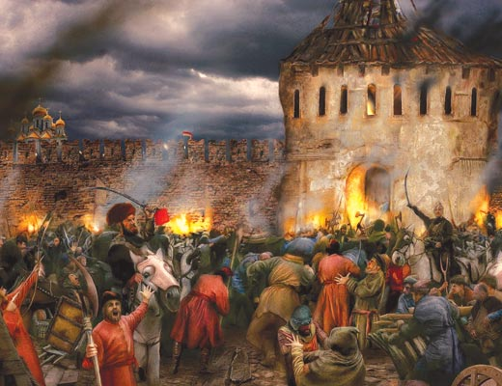
Time of Troubles (1584-1613)

Slide 16
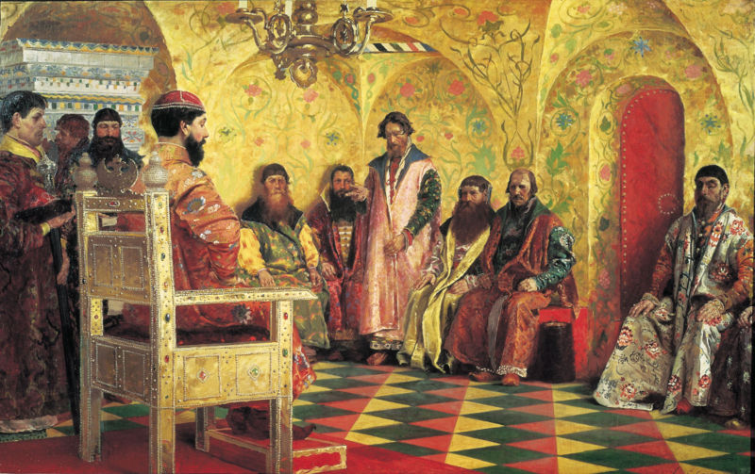
Establishment of the Romanov Dynasty (1613-1917)
Serfdom codified.

Slide 17
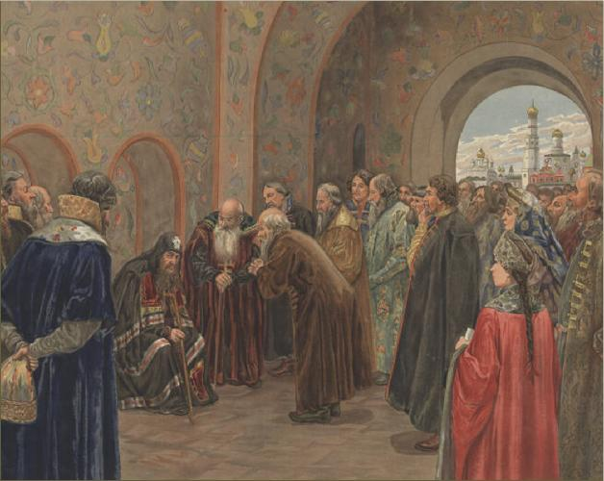
Nikonian Reforms (1652)

Slide 18
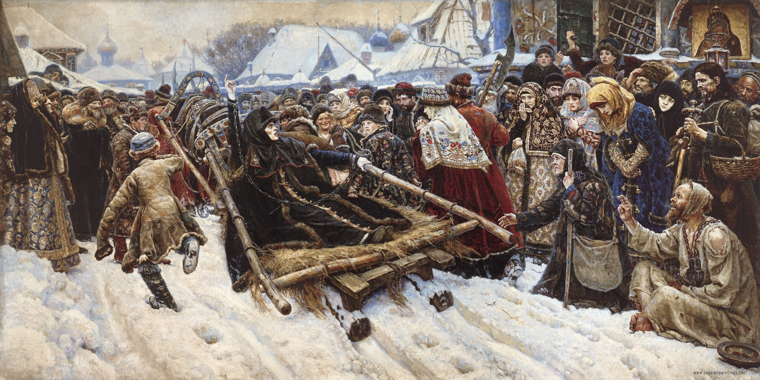
Resistance to the Nikonian Reforms: The Old Believers
Surikov. The Boyarynia Morozova. 1887

Slide 19
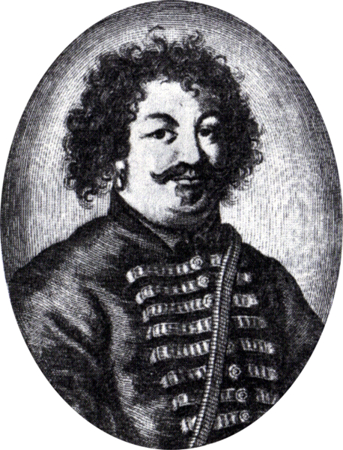
Stenka Razin (1630-1671)
Cossack Leader of Serf rebellion which lasted from 1667-71

Slide 20
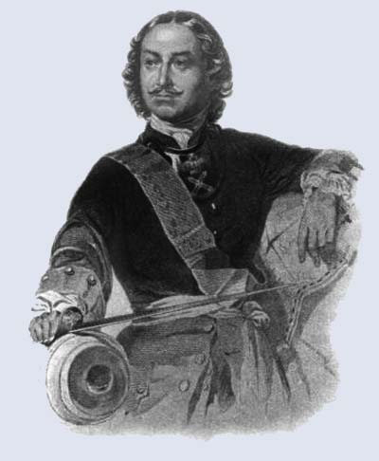
Peter the Great (rules from 1689-1725)
In the twenty year Great Northern War (1700-21), Peter conquered the Baltic States and established St. Petersburg as the new capitol. To compete with the Western European Powers, Peter needed to modernize his army. To do that, he had to establish greater sovereignty over the nobility, make tax collection more efficient, and assert control over the Orthodox Church.
Western Reforms:
  Table of Ranks- Noblemen must work for the state. (two story slavery: noblemen must work.)
  Administrative Colleges- Western style bureaucracies
  Abolishes Patriarchate (Head of Orthodox Church) and makes Russian Church a branch of the government
  St. Petersburg- Nearly overnight, Peter creates a Western European Capitol, built atop the graves of thousands of forced laborers.

Slide 21
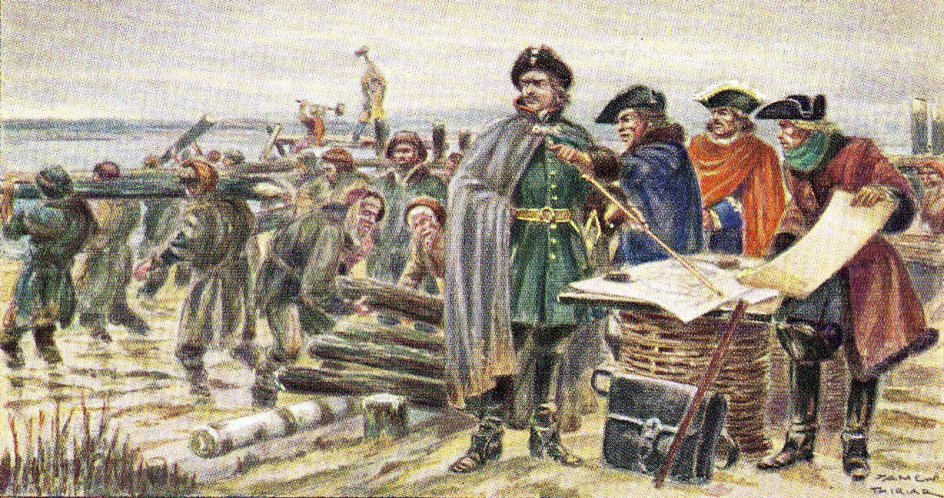
St. Petersburg founded in 1703

Slide 22
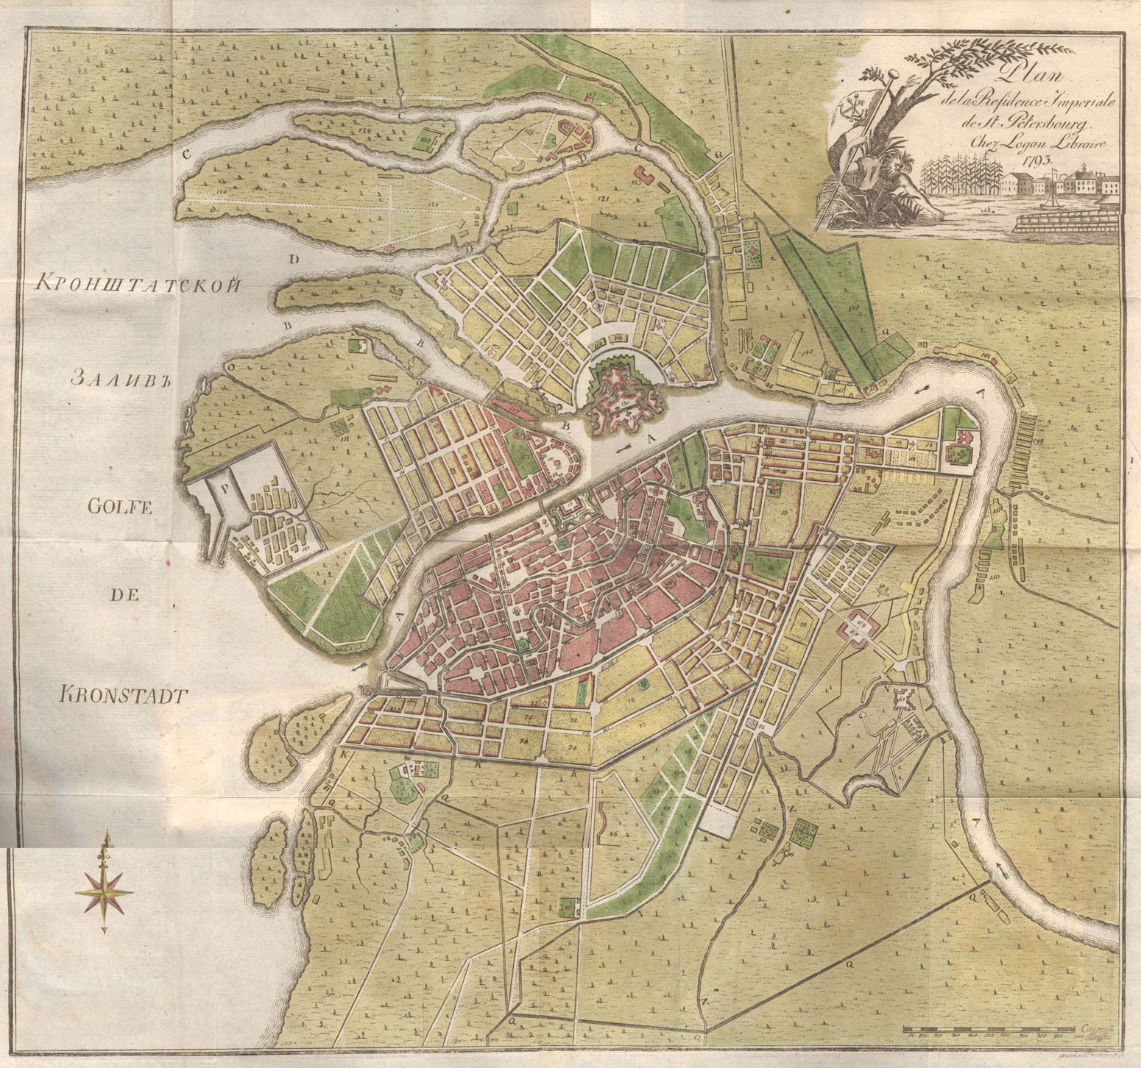

Slide 23
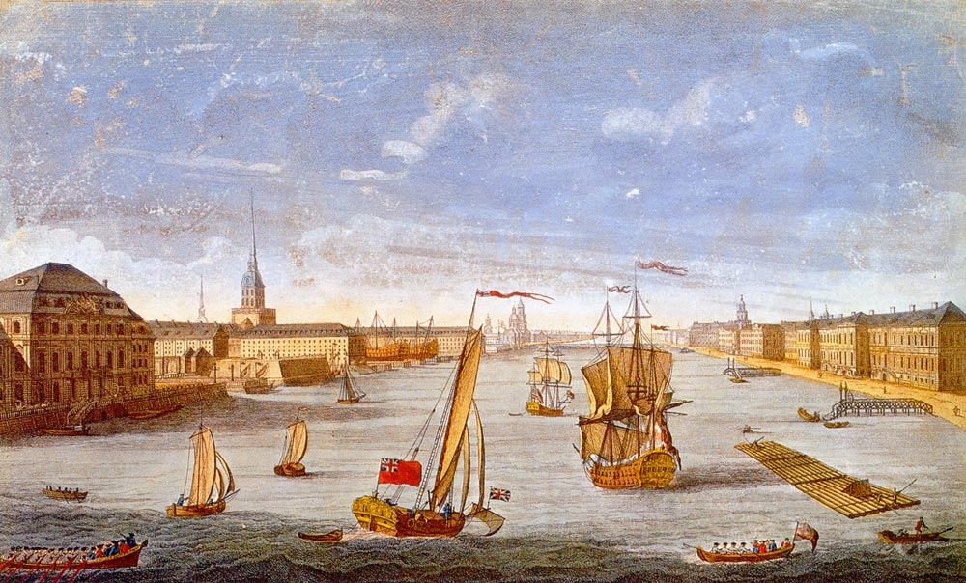
St. Petersburg in 1750: The Venice of the North

Slide 24
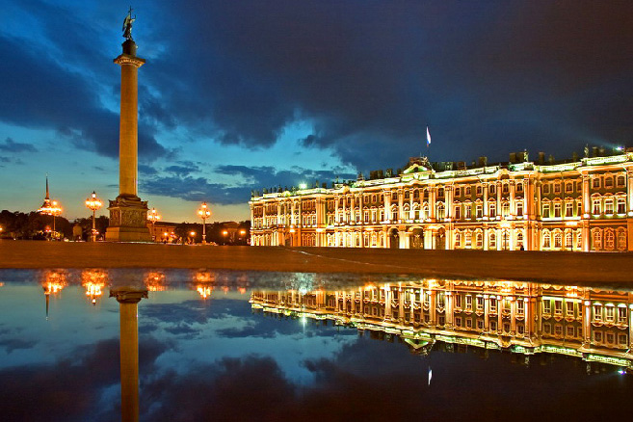
The Winter Palace, 1754- 62; rebuilt in 1837: original architect was the Italian, Rastrelli

Slide 25
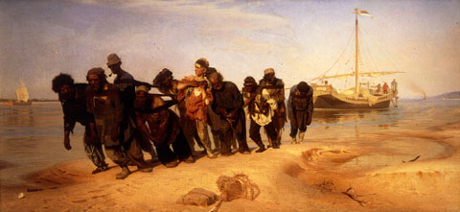

Slide 26
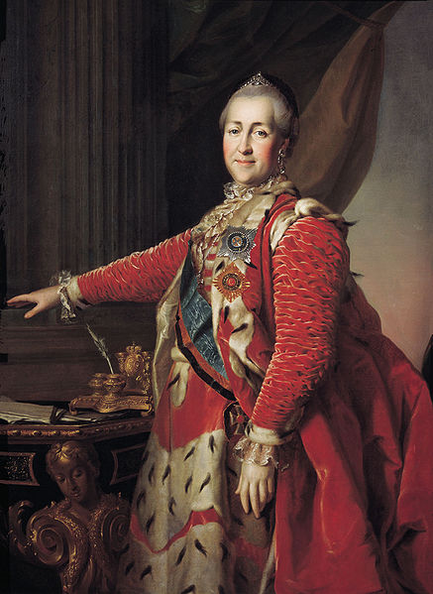
The Enlightenment in Russia
Catherine the Great (1762-1792)
  Models herself as an Enlightened Despot in Voltaire’s model. She promises reform, but backs off when it comes to surrendering her autocratic power due to the Pugachev Revolt (1775) and the French Revolution (1789).
  Enlightenment science does not impact the economy. Russia would not begin its industrial revolution until the end of the nineteenth century.
Successful Wars of Conquest:
  Partition of Poland: land was not returned until after WWI
  Ottoman Empire Wars: Russia expands to the Black Sea
  Peasant rebellions as the Russians spread serfdom. (Pugachev Rebellion)

Slide 27
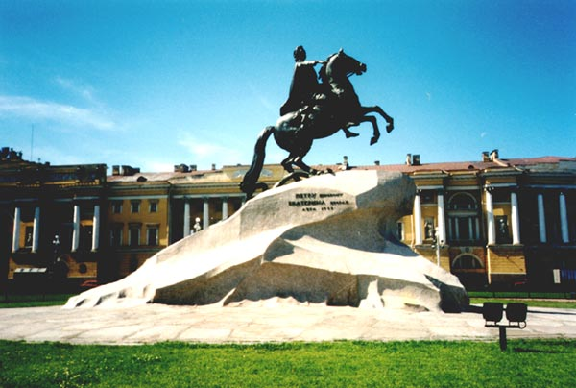
The Bronze Horseman
E. Falconet. "The Bronze Horseman." Bronze statue. 1782. St. Petersburg

Slide 28
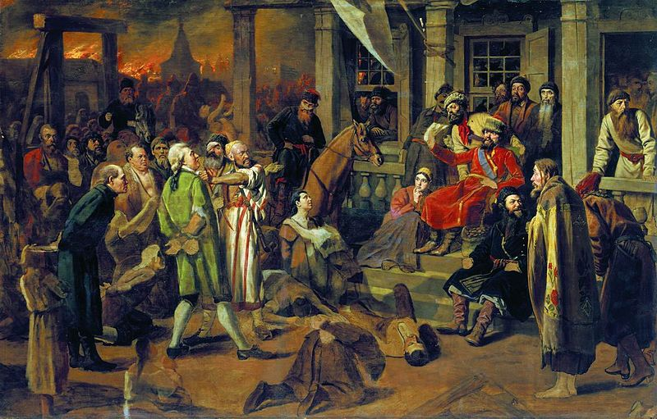
The Pugachev Rebellion: 1774-75
Pugachev's court. V. Perov, 1879

Slide 29
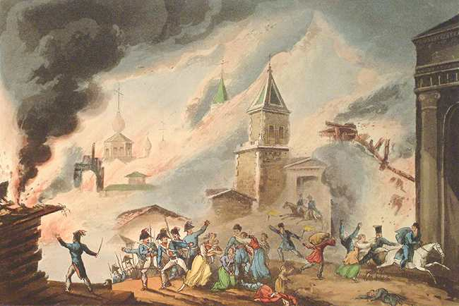
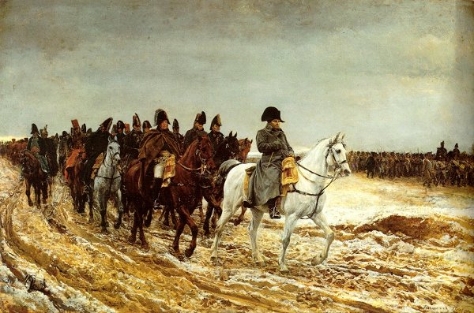
Defeat of the French 1812
Alexander I
  The Russians defeat Napoleon’s armies and establish themselves as the key power in Eastern Europe.
  Like Catherine, Alexander too wanted reform and even had a councilor draw up a liberal constitution.
  However, during the Napoleonic Invasion, and, afterwards, Alexander instead imposes the Arkacheevna: a new police state with intense repression.
  He helps head the conservative forces which made up the Congress of Vienna.

Slide 30
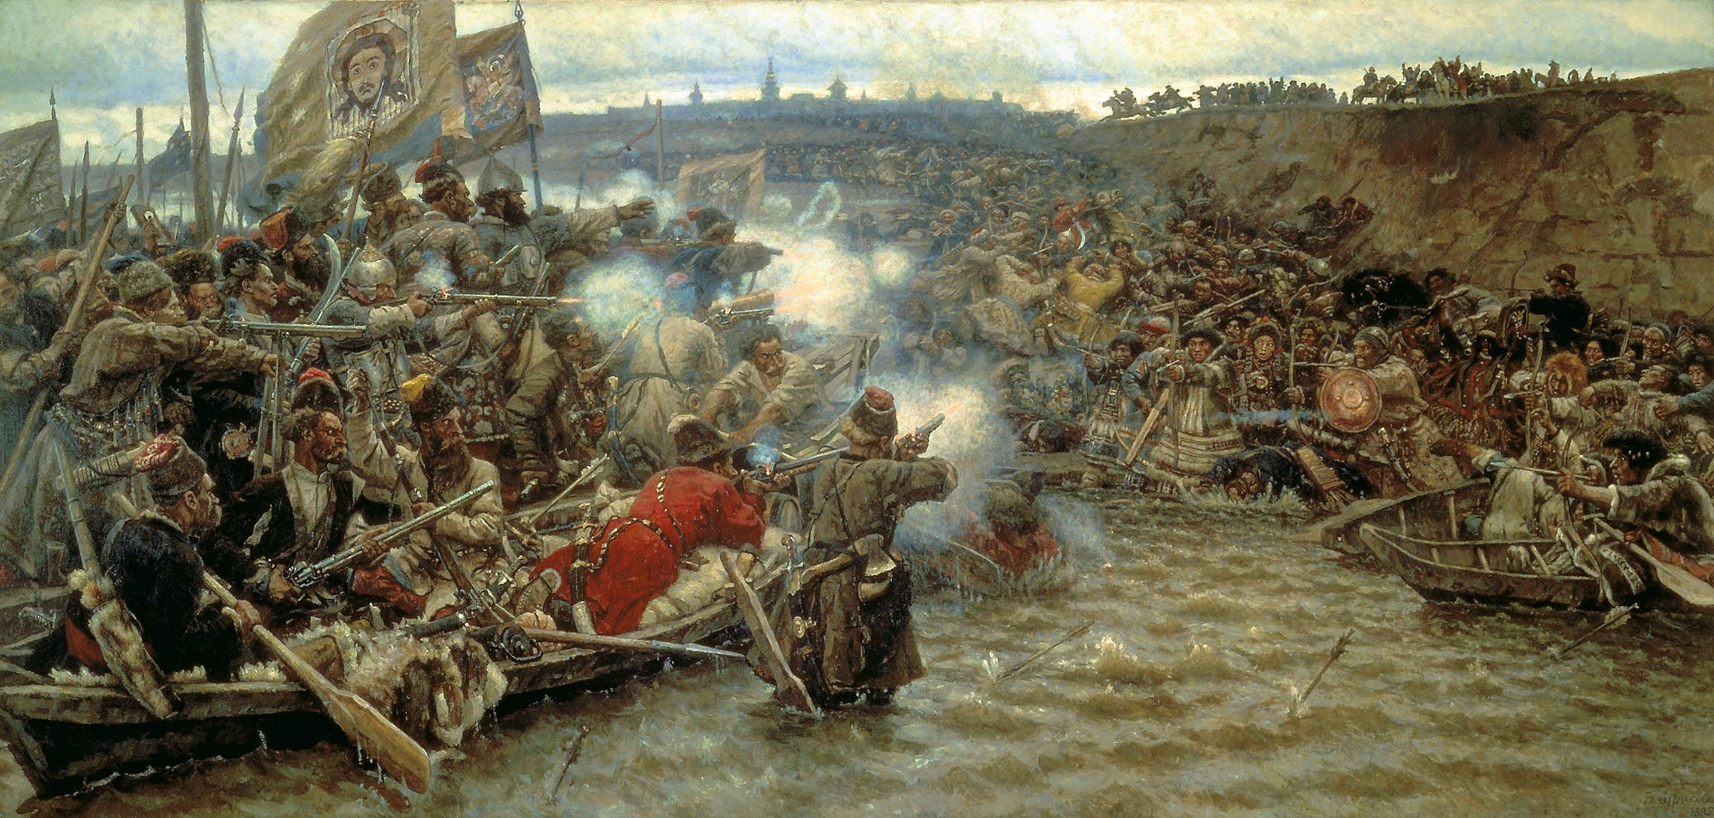
Expansion to the Pacific during the 1860’s
Surikov, Ermak’s Conquest of Siberia (1895)

Slide 31
Nineteenth Century Economic Structure
Inefficient agriculture
  Only 10.8% of the land is arable.
    Permafrost:only top 16” will thaw, creates a swamp
    Pine Forest: acidic soil (Ukraine has most fertile lands)
    Temperature extremes; little precipitation
    Brief growing season
    No mountains to block east/west prevailing winds
  No fertilizer, no seeds, no modern equipment
  Despite hard work of the peasants, the government must import food to feed its people

Slide 32
Early Nineteenth Century Russia
  Political Structure: Autocratic
  Economic Structure: Backward
  Social Structure: Regressive
  Diplomatic Posture: Conservative and Imperialistic Nineteenth Century Tsar:
  Head of a vast bureaucracy and a huge army
  The Tsar’s power depends on his ability to control the nobility:
    Catering to their desires with land grants and job promotions.
    Secret Police to prevent any liberalization of the government’s structure

Slide 33
Early Nineteenth Century Russia
Nobility: (dvorianstvo) 6%
  All nobility are officially registered by the government in a specific rank.
  Most nobility are not wealthy (fewer than 100 serfs)
  Status is measured in rank (mobility through military service)
  Cultural Isolation: Western Education makes the nobility less Russian.
Middle Class: (merchants, doctors, lawyers, urban) 4%
  Tiny size compared with burgeoning Middle Class in England and France which broke the traditional power of the aristocracy.

Slide 34
Peasantry (90+% of the Population)
  Kievan Era
    peasants owned land: the mir: a collective unit
  Muscovite Era: the origin of serfdom
    Tsar’s grant lands to favorite nobles
    14th-15th c.: peasants become tenant farmers
    the Obrok- peasant pays for land with part of crop
    the Barschina- labor tax: peasant owes work to landlord
  Romanov Era: the codification of serfdom
    Ulozhenie of 1649: codification of serfdom
    Peter the Great: poll tax indebted serfs and enabled the tsar to draft them into military service’
    Catharine the Great: geographic spread of serfdom. State serfs owned directly by the tsar.

Slide 35
Nineteenth Century Serfdom
(90+% of the Population)
Obschina: peasant village: the basic organization of peasants before, during, and after serfdom until Stalin
the kulak: Some families could hold and work more land indefinitely and thus profit.
Poor hygiene, illiteracy, alcoholism, intense religious belief
Survival: geared to harsh adversity of Russian climate and culture: “You don’t work; you don’t eat.”

Slide 36
“Whither Russia?”
Political Reform in the Nineteenth Century:
Nineteenth Century Tsars:
  Nicholas I (1825-55) repressive
  Alexander II (1855-1881) reformist
  Alexander III (1881-1894) repressive
  Nicholas II (1894-1917) reformist
Conservative Forces:
  Gentry Self Interest
  Tsar’s Self Interest
  Church’s Self Interest

Slide 37
“Whither Russia?”
Forces for Change:
  Gentry Idealism: liberal writers who have been educated in West, have traveled in Europe, and who look at Russian society through Western eyes (1825: The Decembrist Revolt)
  International Necessity: Russia begins losing wars because of poor technology:
    Crimean War (1856) leads to freeing of serfs
    Russo-Japanese War (1905) - leads to first constitutional monarchy
    World War One (1914-17) leads to Russian Revolution.
  Birth of Middle Class
  Peasant Misery: they want land. Past revolts had been anarchic. By the end of the century the peasants would be better organized.

